Slide 1

Introduction to
https://github.com/arc-moshe/NNIP-LaTeX

Slide 2
Structure of the Talk
Unit 1: Basics
What is ?
How do I use it?
Sample profile design workflow
Unit 2: Deeper Dive
Preamble
Structure
Text sizes & styles
Environments
Lengths
Spacing
Unit 3: LaTable: a Stata table generator for data factsheets
Notes:
The first unit is actually going to run more than 30 minutes, but the second and third units will be less than 30, so it should all come out in the wash.

Slide 3
What is ?
You author a book, and are disappointed with the quality of the typography in the galley proofs. Do you:
A. Suck it up and make do;
B. Find a different publisher; or
C. Author a computerized typesetting system from scratch?
Notes:
Pop Quiz!

Slide 4
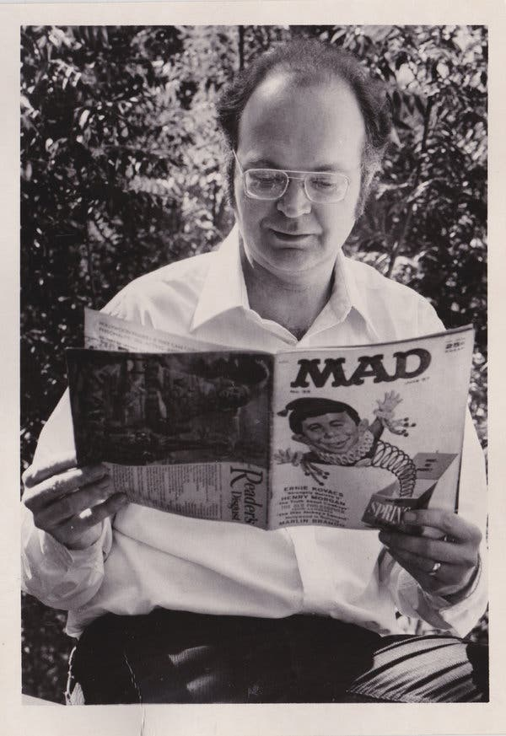


What is ?
Donald Knuth
Turing Award winner
Professor Emeritus, Stanford Computer Science
Author, The Art of Computer Programming
1st edition 1968 (hot metal/monotype system)
2nd edition 1977 (phototypesetting)
Computer Modern typeface
https://www.nytimes.com/2018/12/17/science/donald-knuth-computers-algorithms-programming.html
Notes:
If you answered C, then you must be Donald Knuth. Knuth won the Turing award– effectively the Nobel Prize of Computer Science-- for his work on algorithms. He has been writing a multivolume book on this topic called The Art of Computer Programming for the last several decades. The first edition of one of his volumes was reprinted using phototypesetting (which was commonplace in the 1970s) and he was not happy with the result. As the son of a printshop owner, he had an appreciation for good typesetting.
So Professor Knuth embarked on a side quest and developed three things: TeX, which was the markup system itself.
Per Dr. Knuth, it is pronounced TeK (or tech) and not Tex -- those letters are not t-e-x, but rather tau epsilon kappa, and are an abbreviation of the Greek word techne, the root of English words like technology and technique.
He also wrote Metafont, a system for specifying fonts to be used in TeX
And he designed a typeface called Computer Modern. It is the default base font for TeX, so we'll see some samples in a few minutes.
The NYT calls Knuth the Yoda of Silicon Valley.

Slide 5
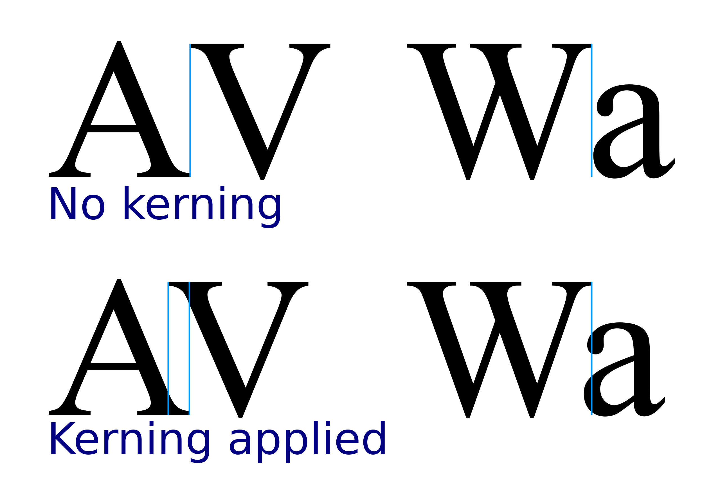
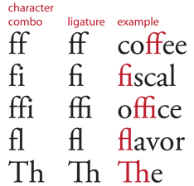
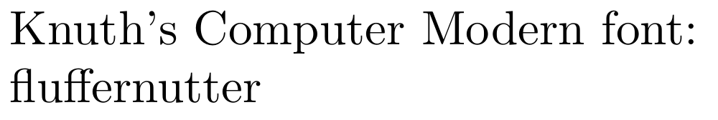
What is ?
Notes:
Dr. Knuth did a real deep dive into typography. Paid a lot of attention to issues like kerning -- the spacing and even overlap between individual characters-- and ligatures-- when two letters are joined to a single glyph. His obsession with getting such details right is why the output looks so aesthetically pleasing. Look at And the ligatures in the word “fluffernutter” and also the kening between the n, u, and t in that same word.

Slide 6
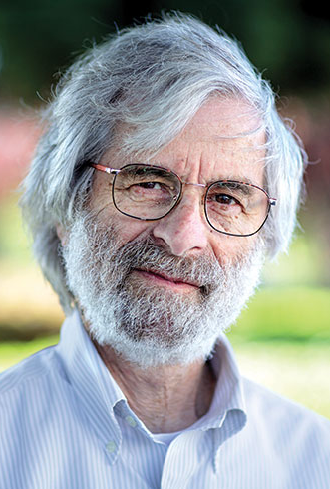
What is ?
Leslie Lamport
Stanford Research Institute
Working on own book, wrote macros that eventually became
Published user manual
Notes:
One problem: TeX was not particularly user friendly. It was written by a guy who programmed in machine language and whose specialty was writing compilers.
It took another computer scientist named Leslie Lamport-- a Turing award winner in his own right-- to make the system we enjoy today. He was typesetting a book he had authored using TeX and realized that the macros he was writing for himself could make a more accessible typesetting system for everyone. And that's how LaTeX was born; the name is a portmanteau of Lamport and TeX.
Lamport also published the first LaTeX user manual, which was crucial to making the system a success. Lamport thought the book might sell a few hundred copies. To his shock, the book sold hundreds of thousands.

Slide 7
What is ?
Fun facts to know and tell:
Free and open source
Markup language
Extensible through “packages”
Cross platform
Device-independent output (e.g., PDF)
Well established and documented
Notes:
So what is LaTeX? [read list]
This last point is really important: it means that you can get meaningful (and usually right) help from Copilot, Gemeni, or Claude when you get stuck.
LaTeX is also a shibboleth to identify fellow nerds (a CV or resume set in LaTeX stands out from ones generate in, say, Word)
And my favorite thing about LaTeX: you can use scripting to automate the creation of many documents– what we’ll be looking at very soon.

Slide 8
What is ?
Competitors
ConTeXt
TeX-based, open source
More built-in functions (less need for packages)
Simpler macros
R Markdown
Free, open source
R package
Uses markdown syntax
Typst
Freemium model
Markdown-like syntax
Not as capable for complex documents
Notes:
It’s worth noting that LaTeX is not the only game in town… So look into these alternatives before investing your time in learning LaTeX. The automation piece I’ll demonstrate later in this unit could be adapted to any of these systems as well.

Slide 9
Structure of the Talk
Unit 1: Basics
What is ?
How do I use it?
Sample profile design workflow
Unit 2: Deeper Dive
Preamble
Structure
Text sizes & styles
Environments
Lengths
Spacing
Unit 3: LaTable: a Stata table generator for data factsheets
Notes:
So now that you know what LaTeX is, how do you use it?

Slide 10
Using
Online Systems
Overleaf
CoCalc (designed for collaboration)
Offline Systems
MikTeX (Windows, Mac, Linux)
MacTex (Mac)
Notes:
There are a few ways to get started with LaTeX. You can sign up for an online service, like Overleaf (basic account is free) or install software on your local computer. I use the cross-platform MikTex, but some mac users prefer MacTex.
Any of these setups will provide you with an IDE-like environment: code in one window, messages in a console, output in a third. Because it is a markup language, you can also code LaTeX in any text editor and then run a compiler to yield your final document.

Slide 11
Using
Document consists of two parts:
Preamble
Document class– Required!
Packages
Macros
Other definitions, e.g., colors
Document
\begin{document}
\end{document}
Comments
Compiler will ignore everything from % to the end of the line
Need a percent sign? Escape it: \%
Command format: \command[optional]{required}
Notes:
A LaTeX file consists of two parts: the preamble and the document itself.
The preamble is where you initialize the file-- the "class" of document to be created, any packages to load, any custom definitions like macros or colors. The document class is a required element of the preamble. Everything else I mentioned is optional.
Then the document content lies between a begin document tag and an end document tag. Everything between those tags is evaluated for typesetting. Anything located after the end document tag is ignored, so you can leave comments there if you like.
You can also make comments within the document. Just preface your comments with a percent sign. Anything that falls on a line after a percent sign is ignored by the compiler, unless you escape the percent sign (in order to use it as an actual character). There are other special characters like the backslash, ampersand, dollar sign, curly braces, and pound sign (aka hash) that must also be escaped.
Commands typically follow this form: backslash, then the command name, followed by any optional parameters inside a set of square brackets, and finally required parameters within curly brackets.

Slide 12
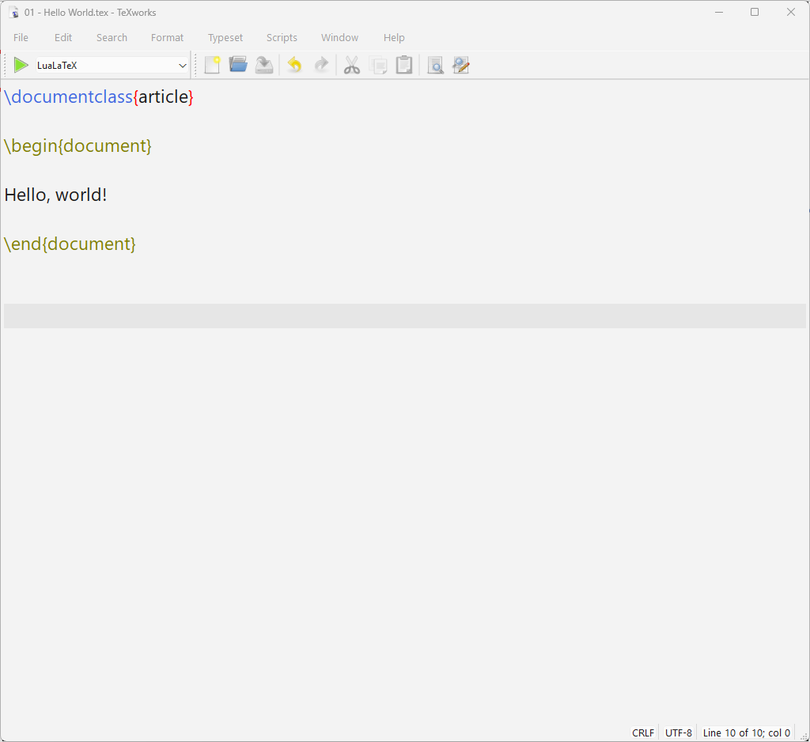
article class
Notes:
OK, yawn, enough theory. Let’s put this all into practice with a short demo.
Here's a screenshot from TeXworks, the console system that comes with MikTeX. Note that it provides syntax highlighting.
This is the simplest possible document: one line preamble, and a simple nugget of text between the begin and end tags.
As a nod to every programming tutorial out there, we'll just have the document say hello world.
You get a choice of compilers. We’ll use LuaLaTeX because it supports TrueType fonts, something we’ll want to use in a few minutes.
Compile by hitting the green go button…

Slide 13

Notes:
…And you get a page with fairly wide margins (like you might find in a journal article) and a page number at the bottom. And our text appears in Computer Modern.

Slide 14
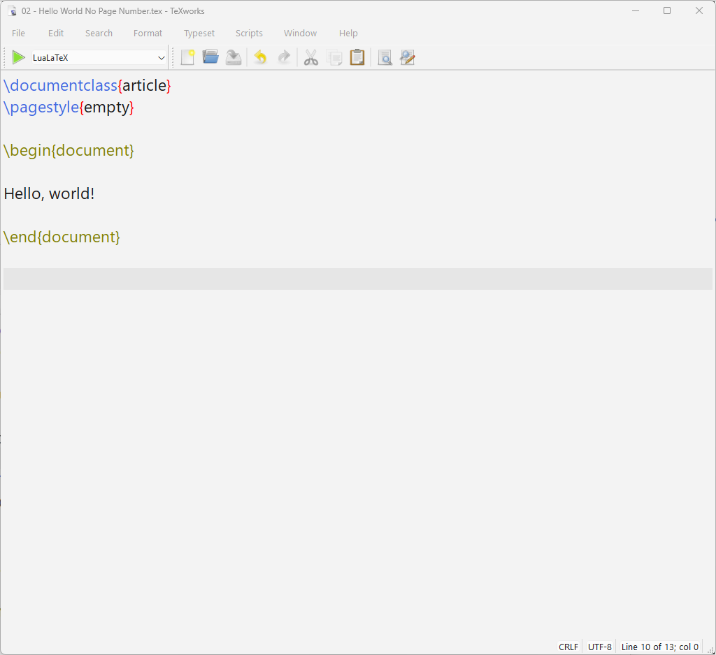
empty pagestyle
Notes:
Naturally, the article class isn't the only one available, but it is a good default. And if you don't want page numbers, you can change that by adding another line to the preamble-- a command setting the page style to empty (no headers or footers).

Slide 15
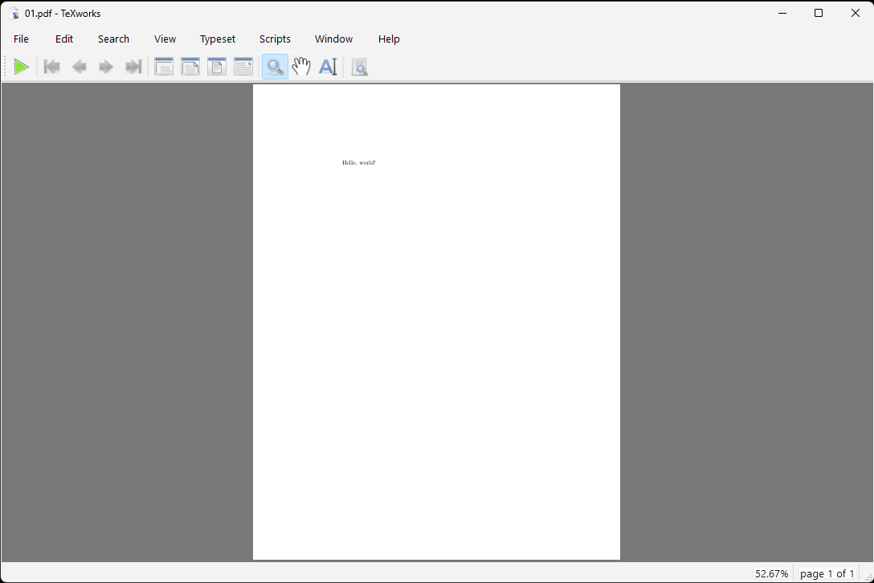
Notes:
And that gives you this output-- identical to before, only no page number-- just as we asked.

Slide 16
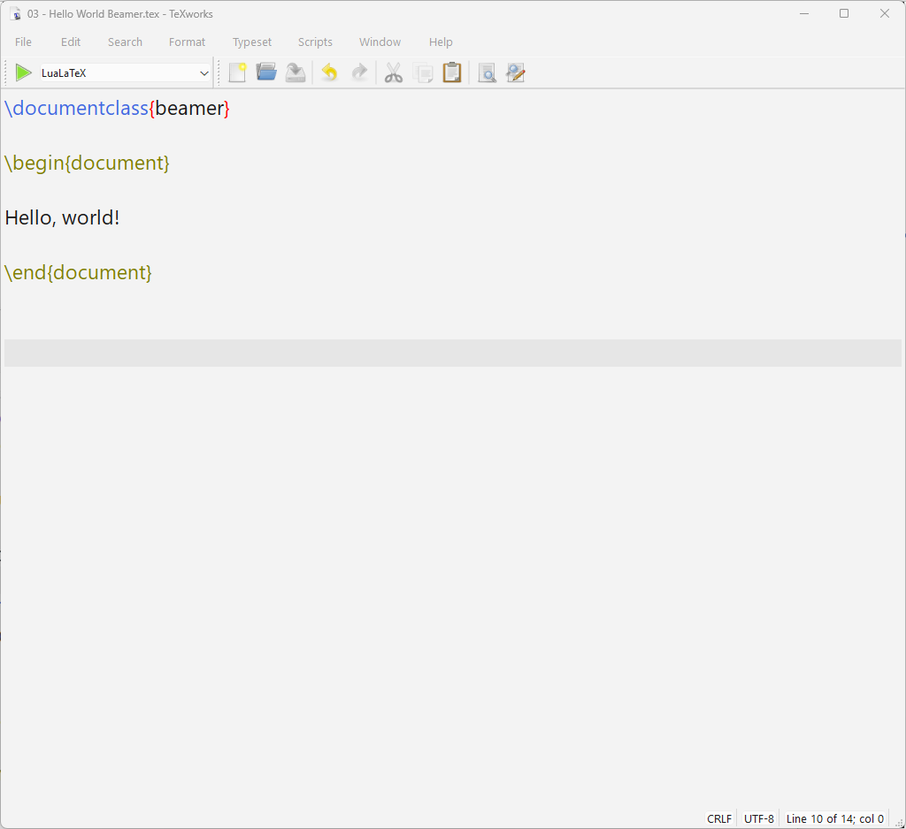
Beamer class
Notes:
Another document class is beamer. It's designed to make slides. So, if we change the class, we’ll get the same content but in a different document setup entirely.

Slide 17
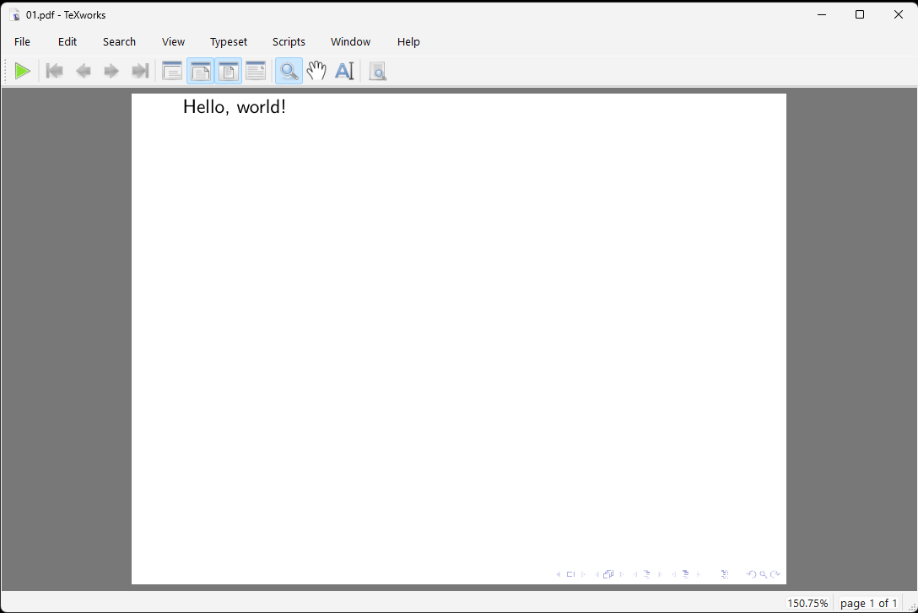
Notes:
Now the page is landscape-- like your typical slide would be; the base font is now sans serif, which makes for easier to read slides.
Beamer has no page numbers by default. AND there are some navigation buttons in the lower right-hand corner to let you move around the deck.
The upshot is that different document classes will render identical content differently depending on the specific purpose of the document.

Slide 18
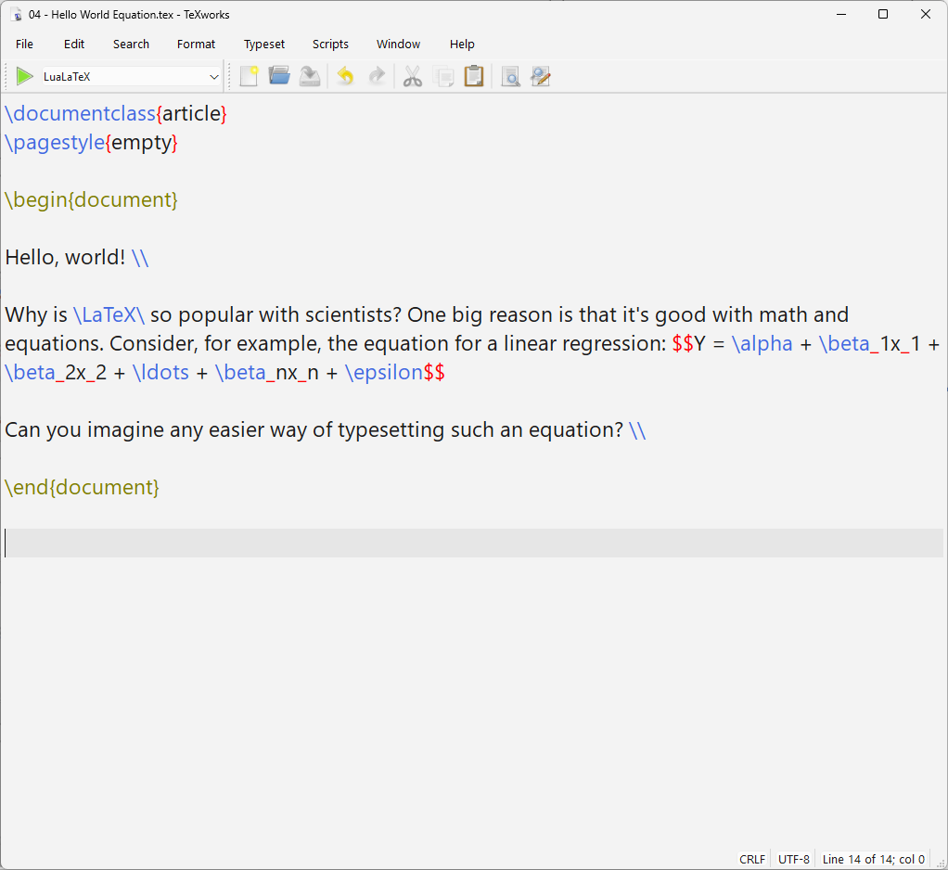
Glyph
Math Mode
Notes:
Returning to the article class, let’s build out our document a little.
First, I added the LaTeX glyph. You can also put other symbols into documents, but most require external packages. I recommend the fontawesome package if you're interested in such things– more about that later.
Second, you've got those dollar signs showing in red thanks to syntax highlighting. The dollar sign tags put you into and out of math mode which is why dollar signs to appear as actual dollar signs must be escaped.
Math mode comes in two flavors: a single dollar sign will have the math equations print in line with the text. A double dollar sign puts you in display mode-- the equation will appear on its own line, like you'd see in a textbook or journal article.
Let's look at it. Y = alpha + beta sub 1 x sub 1 + beta sub 2 x sub 2 + some dots + beta sub n x sub n + epsilon.

Slide 19
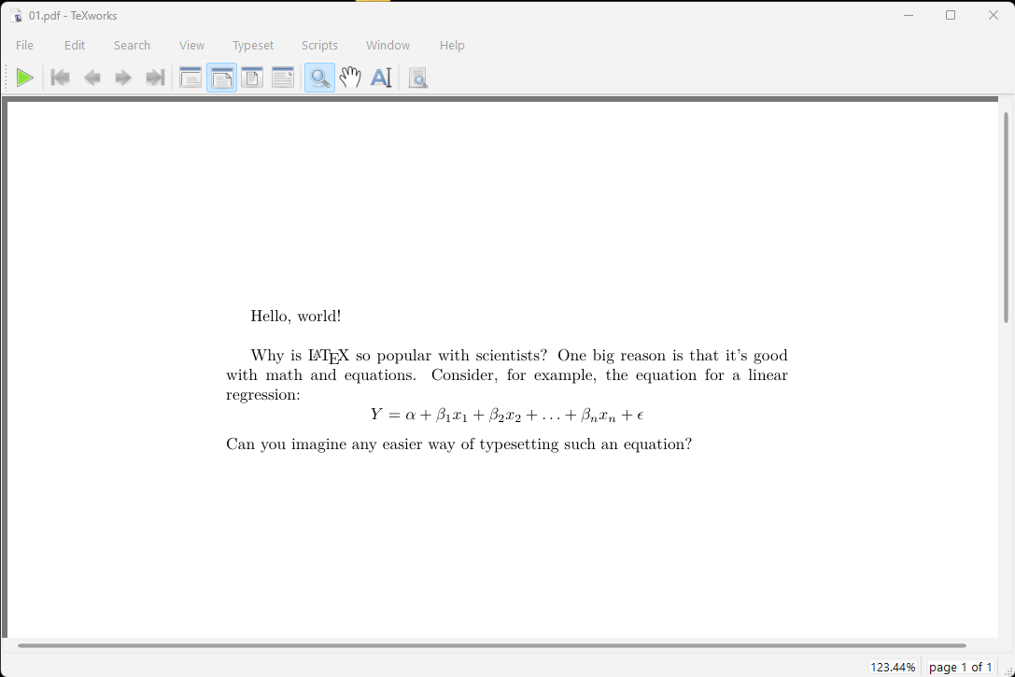
Notes:
And see how that renders. You get a nice-looking equation with minimal fuss.

Slide 20
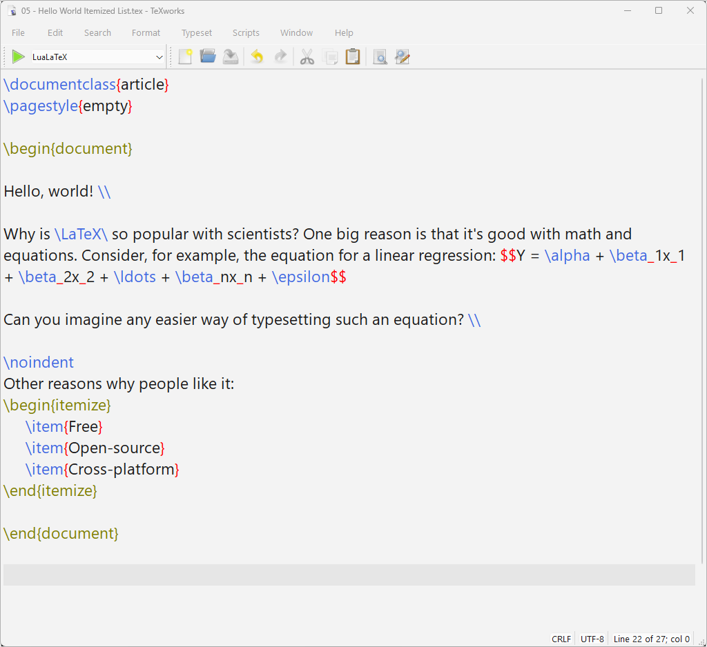
Itemized List
Notes:
LaTeX is good with bulletized lists -- you put the list items between itemize tags.

Slide 21
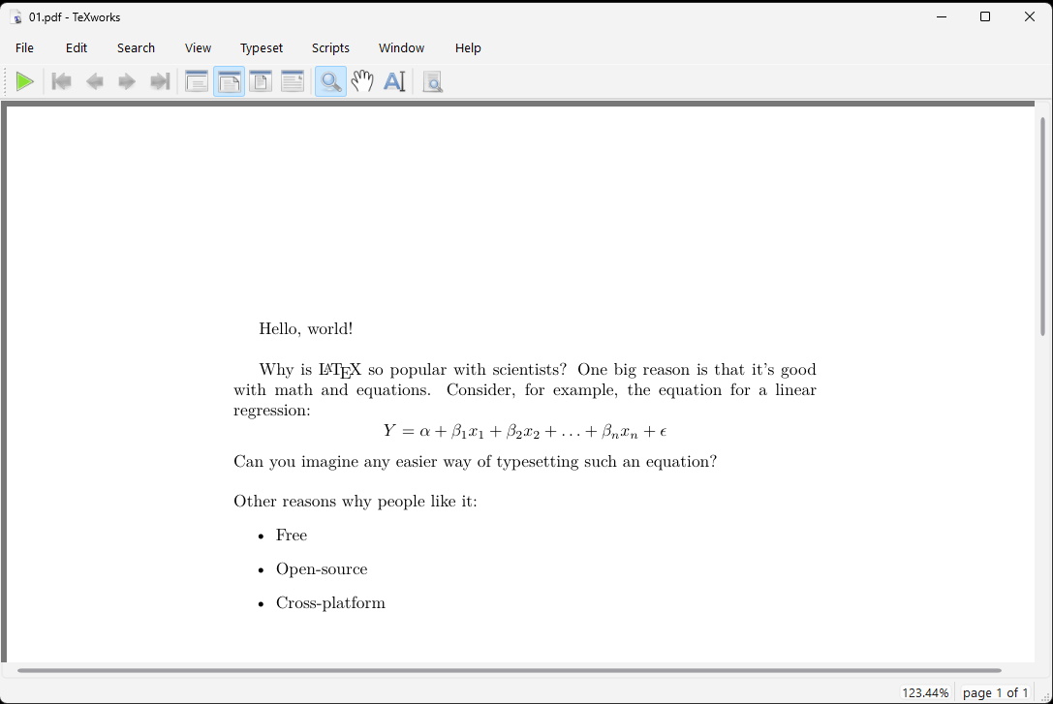
Notes:
Here’s the result.

Slide 22
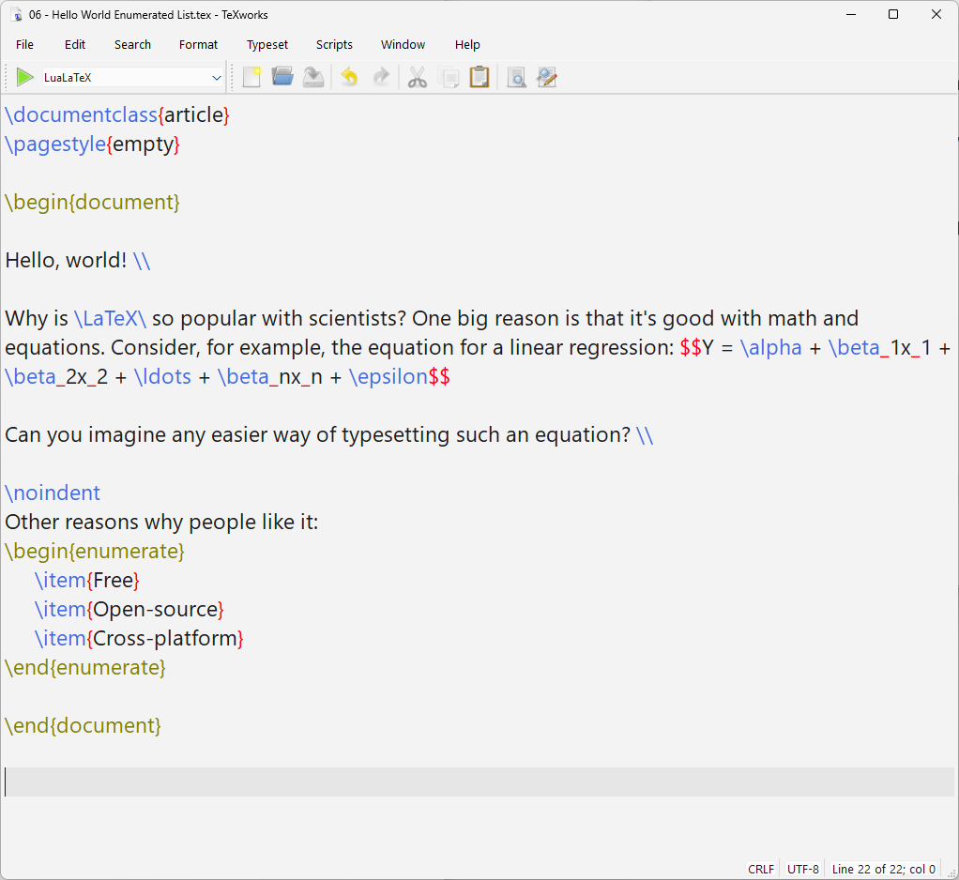
Enumerated List
Notes:
Or if you want the list numbered, change the word “itemize” to “enumerate”.

Slide 23
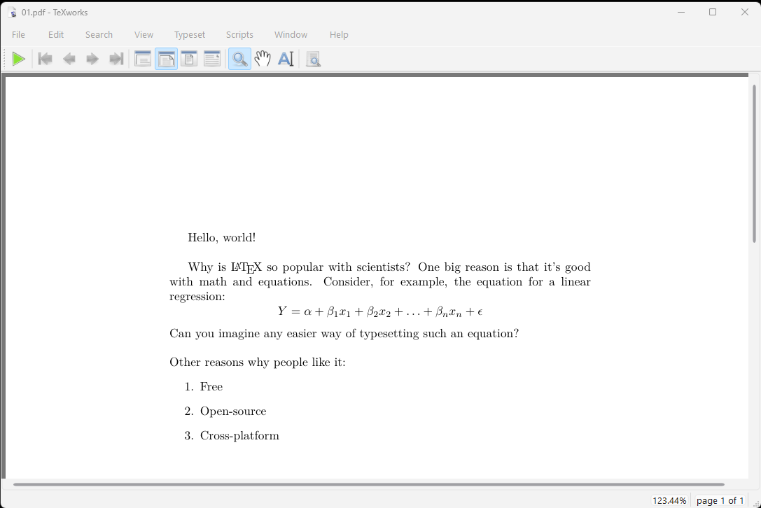
Notes:
And here’s how that renders.

Slide 24
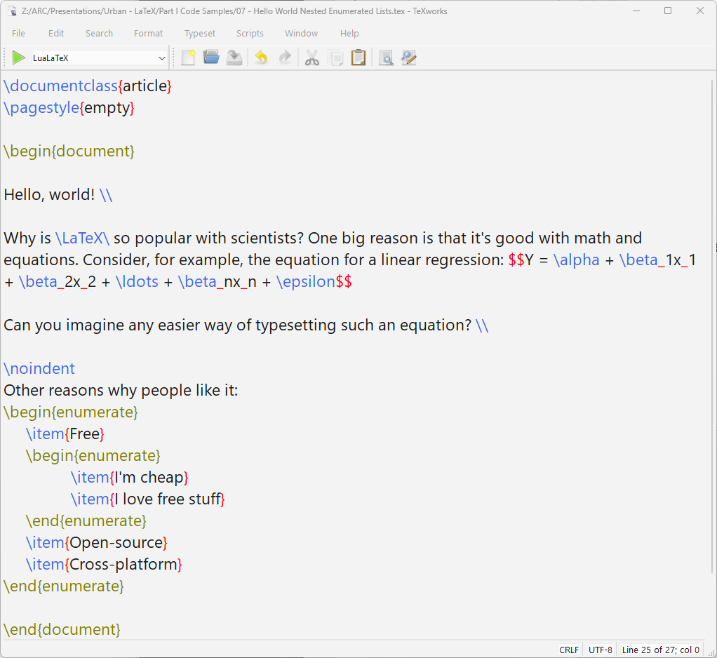
Nested Enumerated Lists
Notes:
You can also nest itemize or enumerate tags to yield subitems. Note to our Pythonic friends, this indentation of the nesting structure is NOT required. I just did it to make it more human readable.

Slide 25
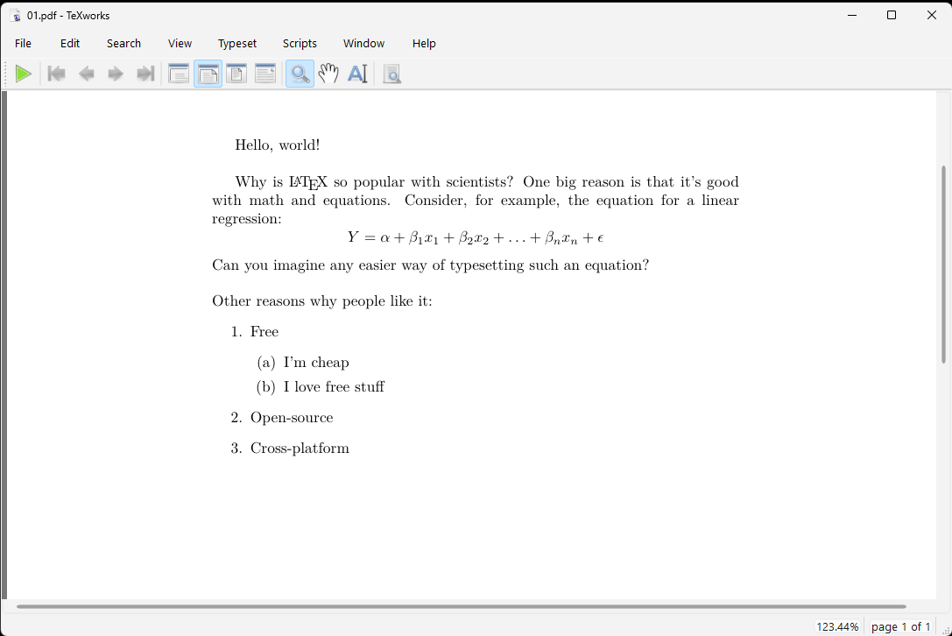
Notes:
And here's the result, much like you'd expect.

Slide 26
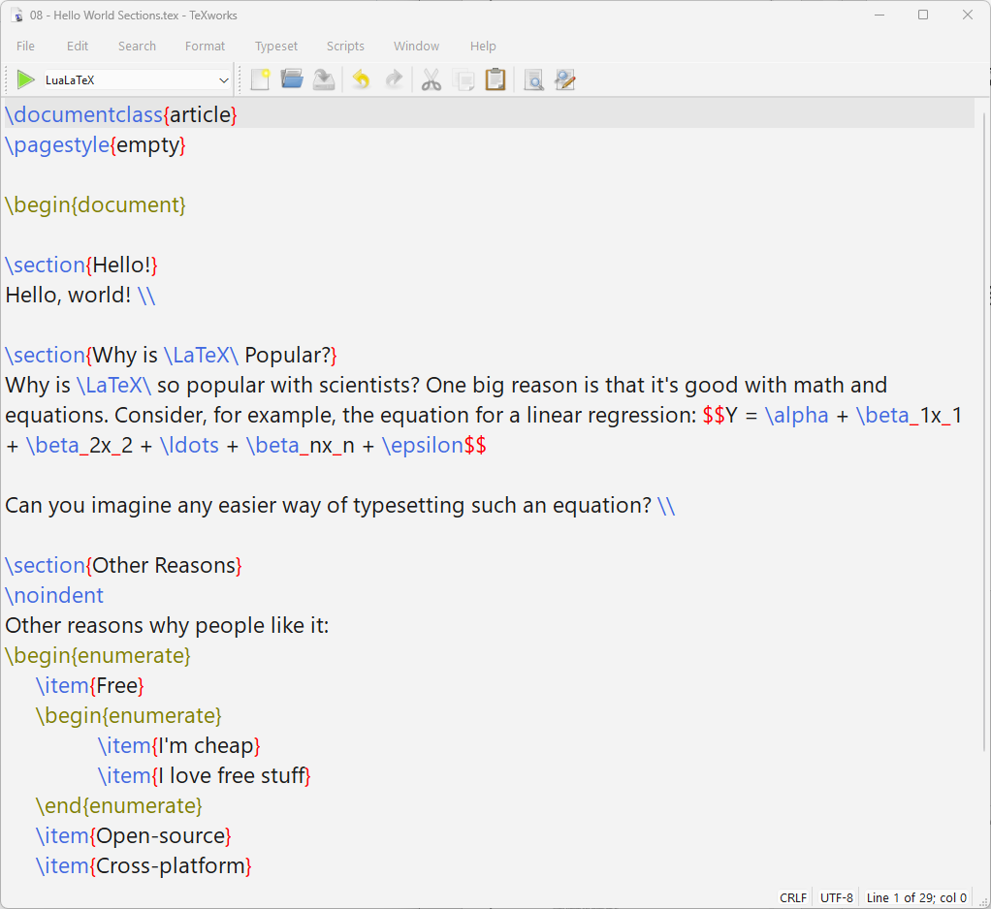
Section
Heading 1
Section
Heading 2
Section
Heading 3
Notes:
LaTeX is also really good for long documents like books and dissertations because it helps keep track of the document structure. I've just added some section headings between the various paragraphs:

Slide 27
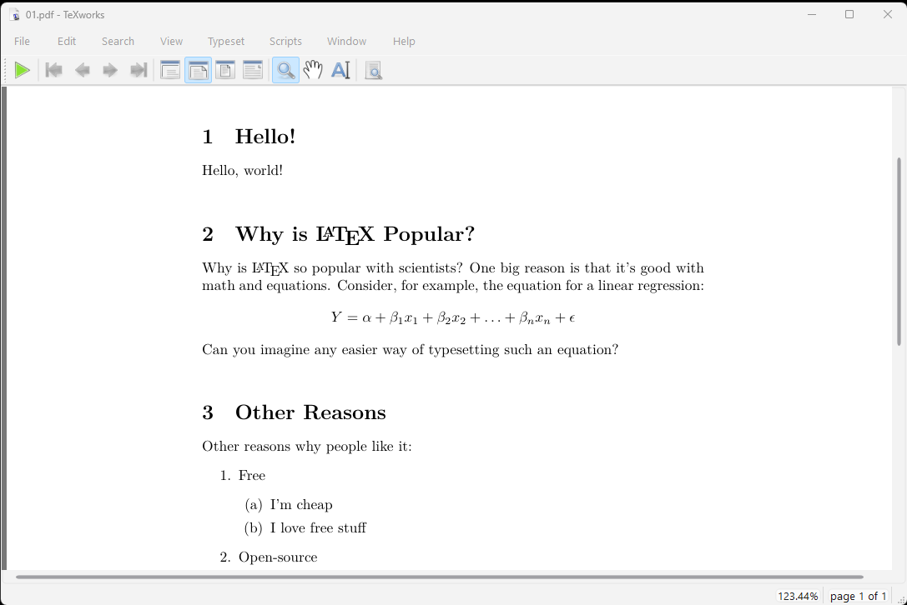
Notes:
Those sections get numbered. If you use the book class instead of the article class, then you can identify chapters in addition to sections.

Slide 28
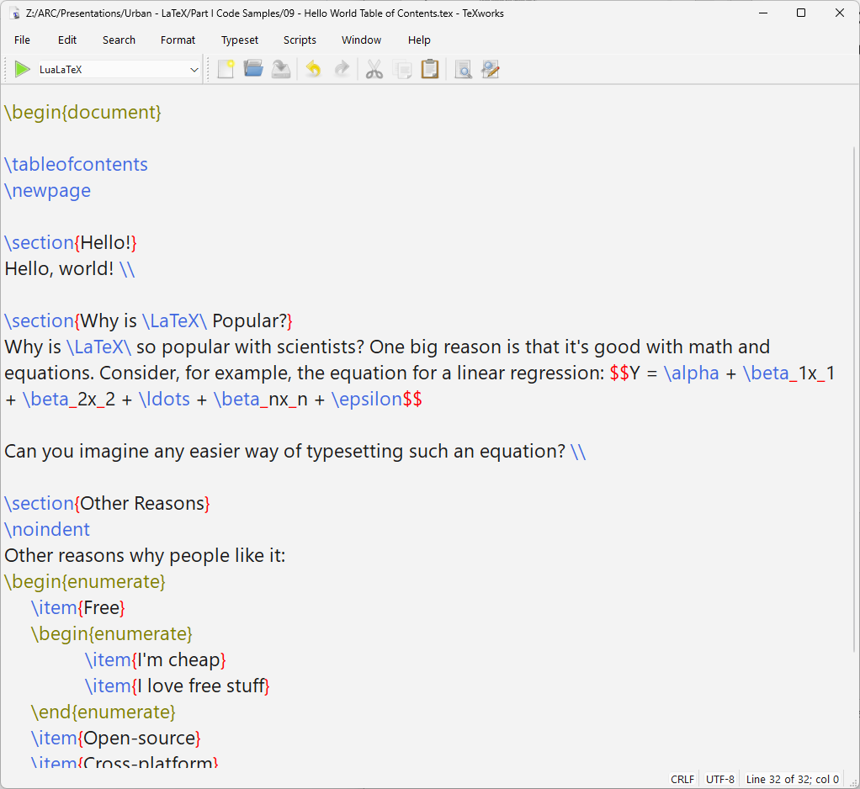
Table of
contents followed by
page break
Notes:
And if you ask for one, then LaTeX will generate a table of contents using that section information. Here I've asked for the table of contents, then a page break, and then the main doc.

Slide 29
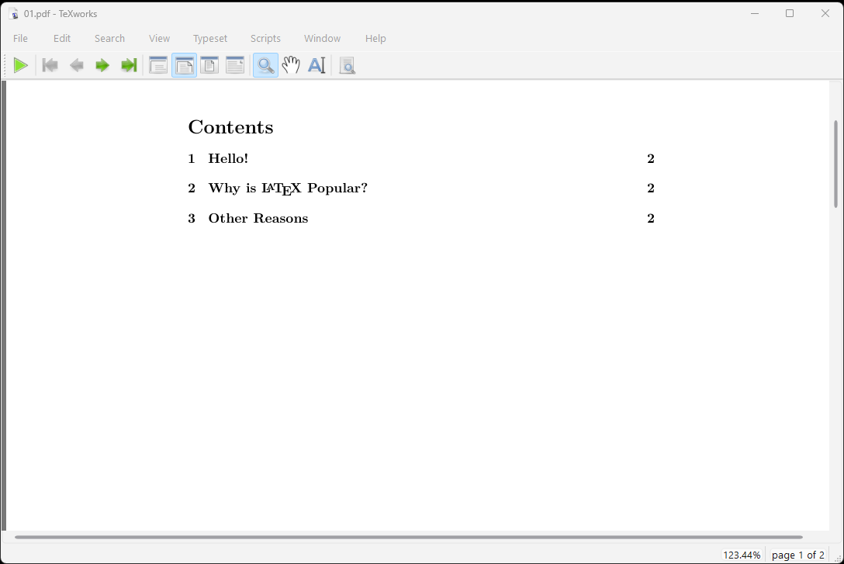
Notes:
Because the toc is page 1, the section heads are all on page 2.

Slide 30
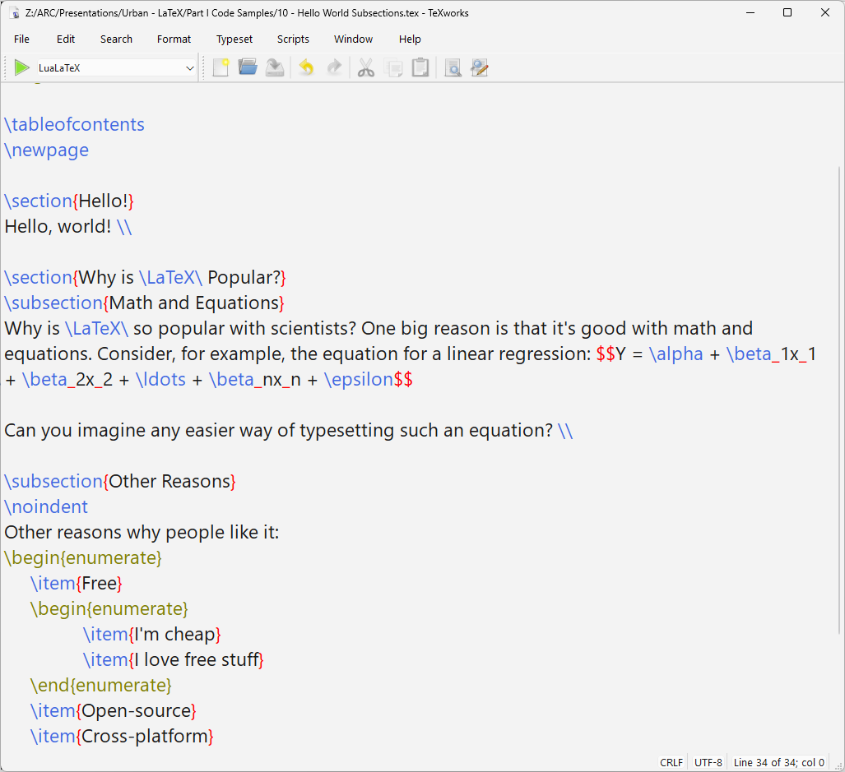
Section
Headings
Subsection
Headings
Notes:
You can also define subsections (or even subsubsections).

Slide 31
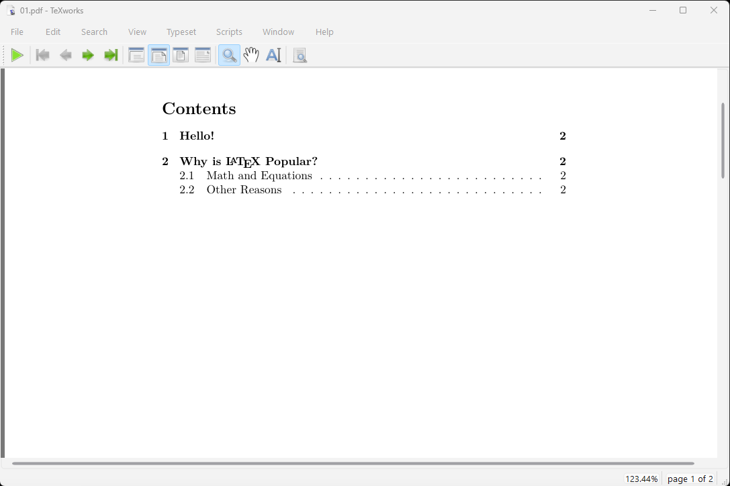
Notes:
And again, those would automatically number in the document and table of contents much as you'd expect.
I don't have time to demonstrate everything worth knowing, but I also want to note that LaTeX also does a great job with footnotes and endnotes. And there is a program called BibTeX that allows you to manage bibliographies. You define your sources in a database, and then tell LaTeX what reference style to use. If you've ever written a paper in MLA format only to learn that the journal you're submitting to uses Chicago style (or vice versa). I'm sure you would understand how useful that would be. In that sense, BibTeX a free replacement for commercial software like EndNote or Zotero. But you can also use EndNote or Zotero with LaTeX if you’re already working with one of those.

Slide 32
Structure of the Talk
Unit 1: Basics
What is ?
How do I use it?
Sample profile design workflow
Unit 2: Deeper Dive
Preamble
Structure
Text sizes & styles
Environments
Lengths
Spacing
Unit 3: LaTable: a Stata table generator for data factsheets
Notes:
Now that you have a basic understanding of LaTeX, we can talk about how to leverage it to make those dreaded data factsheets.

Slide 33
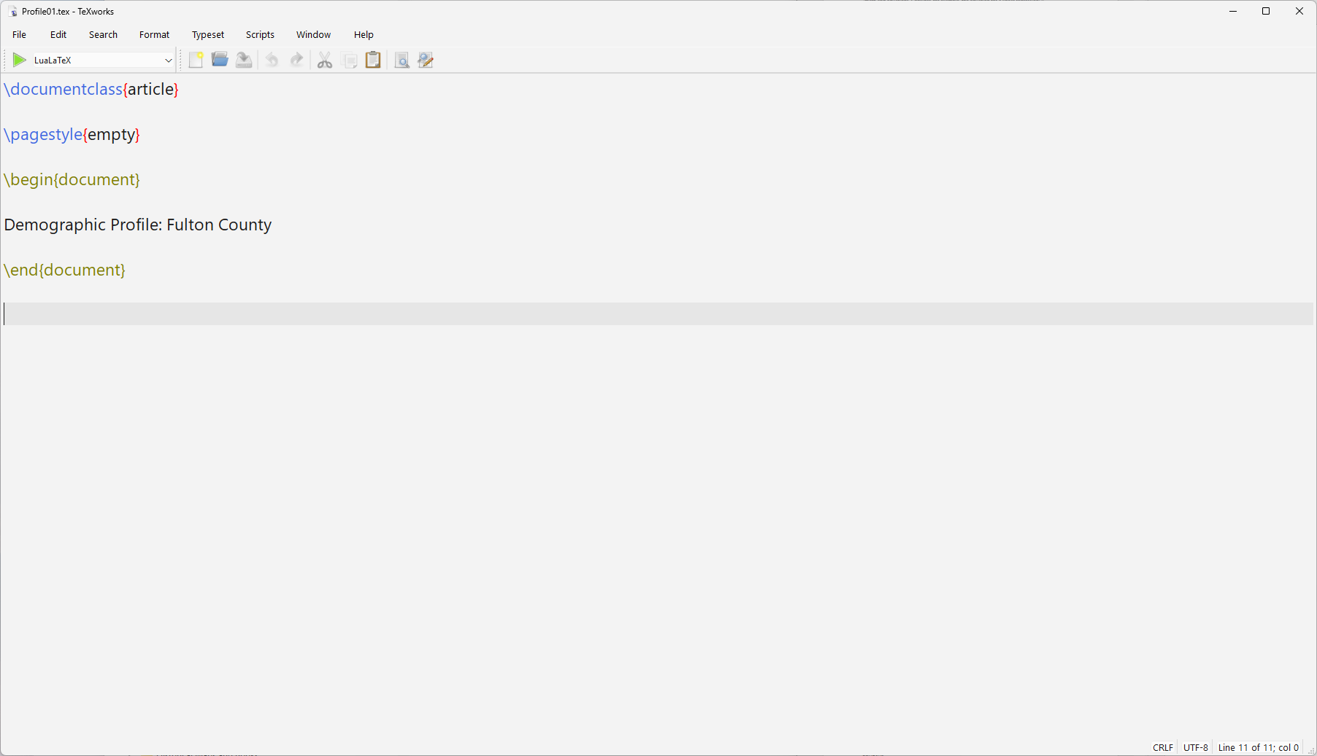
Notes:
The first step is to design a sample report.
We'll start with a basic article class document, pagestyle empty so no page number. And we'll call it Demographic Profile for Fulton County. Once we have the design down, we’ll write code to generate a batch of reports.
Also note that for each step, the filename will be Profile01, Profile02, and so on. The code for all of the steps are part of the payload on GitHub.

Slide 34

Notes:
So far, so good. But maybe we'd like that title to be centered and a bit larger.

Slide 35
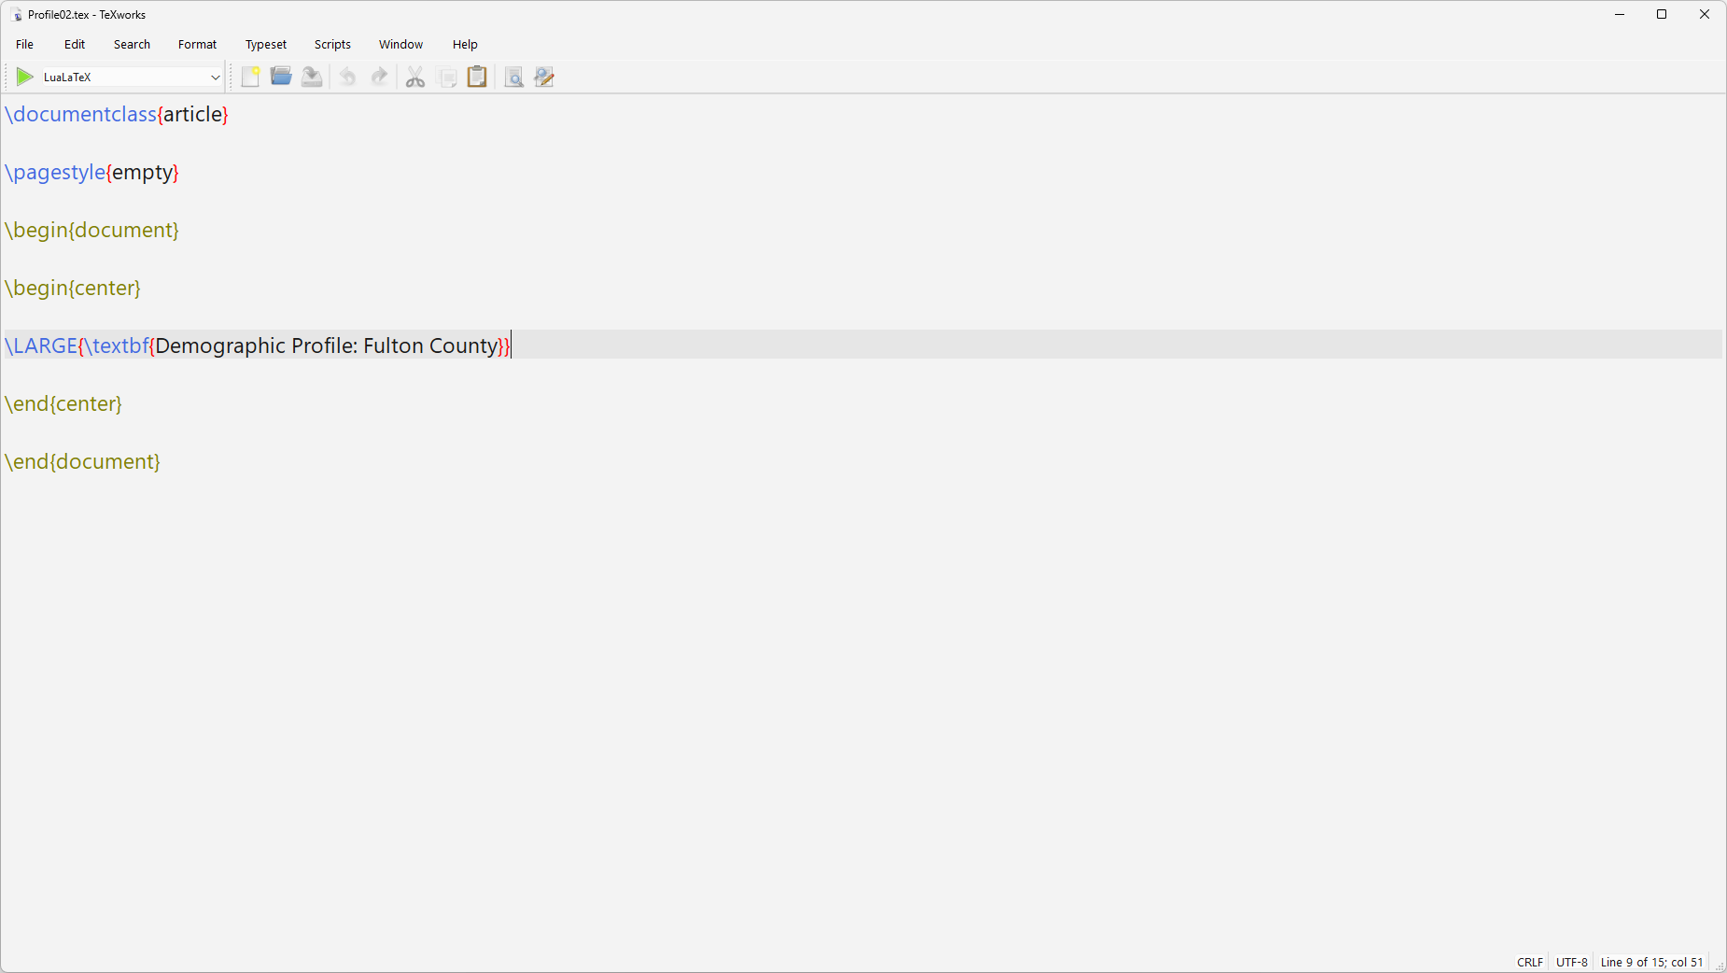
Notes:
So, we'll use the center environment to center the text and our text in some nested tags for large and bold face. It's a lot like HTML that way in that you can nest styles, but since the end tag is always a right curly brace, you just have to count the right number (and not worry about the order of the end tags)

Slide 36

Notes:
That’s better.

Slide 37
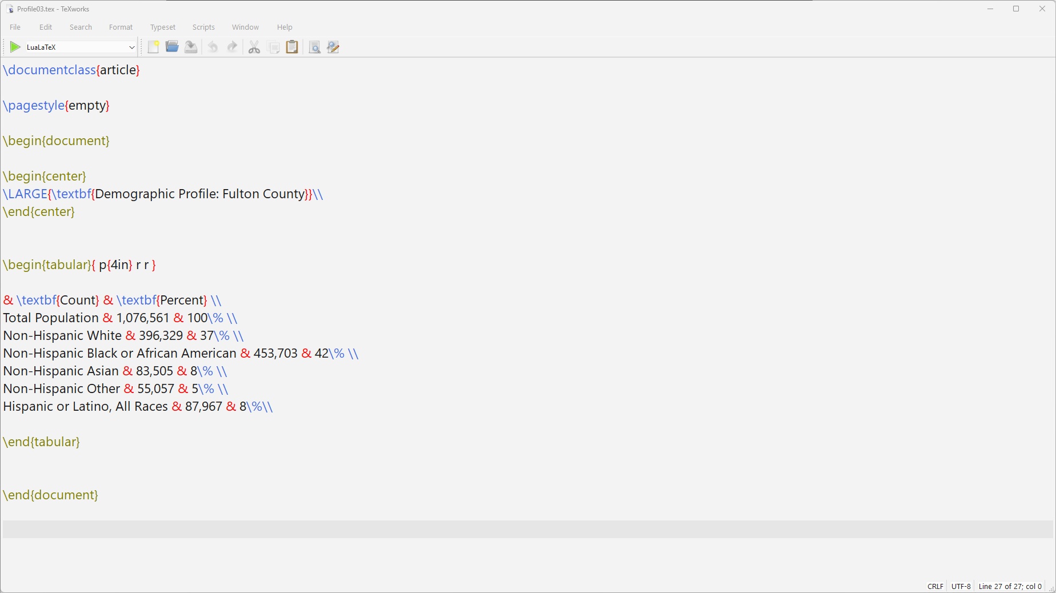
Notes:
Now, we'll want to add a table of data. There are a bunch of available table environments, but tabular is the simplest one.
Note that there's a “begin tabular” and an “end tabular” just like you have for the begin/end document.
Next, we have to tell it how many columns we want and the column formatting. You can use lower case L for left justified, c for center justified, and r for right justified columns. Those columns will automatically size to their contents.
But you also may want to set the size of a column, especially if it contains long text, because then it will wrap. In that case you use p for paragraph, which is also left justified. Using the p specification also REQUIRES you to set the width, which I have done here at 4 inches (more about what units you can use later).
So, we'll have three columns in our table: one left justified 4 inches wide, the other two right justified sized to the width of the text-- plus a little padding.
If you need to set the width of a centered or right justified column, then you have to employ some hacks. But not needed here. Note: the whitespace between the p and among the r’s is optional—I included it to make it easier to read.
OK, next line will be my table head, so I put the text in boldface.
In LaTeX, the table columns are separated by ampersands. So, the top line has an empty cell, then my headers for the other two columns.
The double backslash gets me to the next table row. Finally, note that the percent sign is escaped so that LaTeX knows not to treat it as a comment.

Slide 38
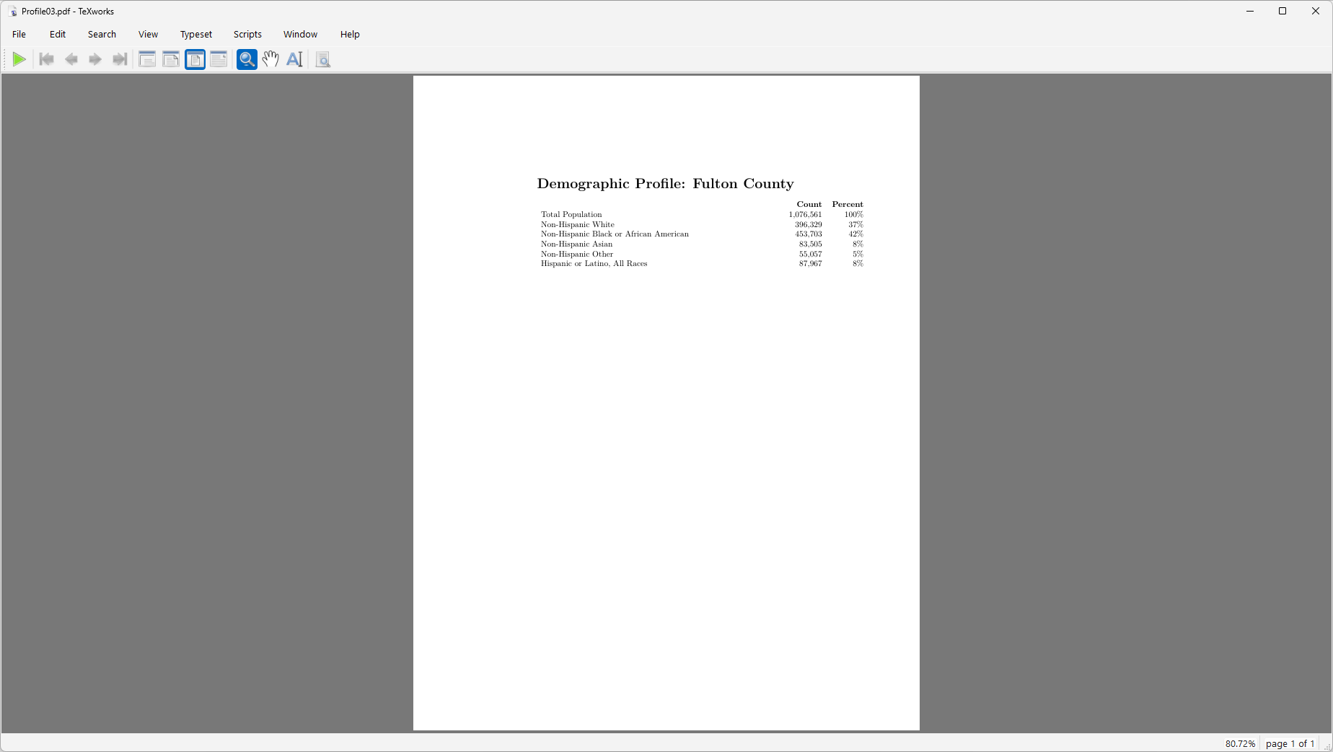
Notes:
Which compiles to this table.

Slide 39
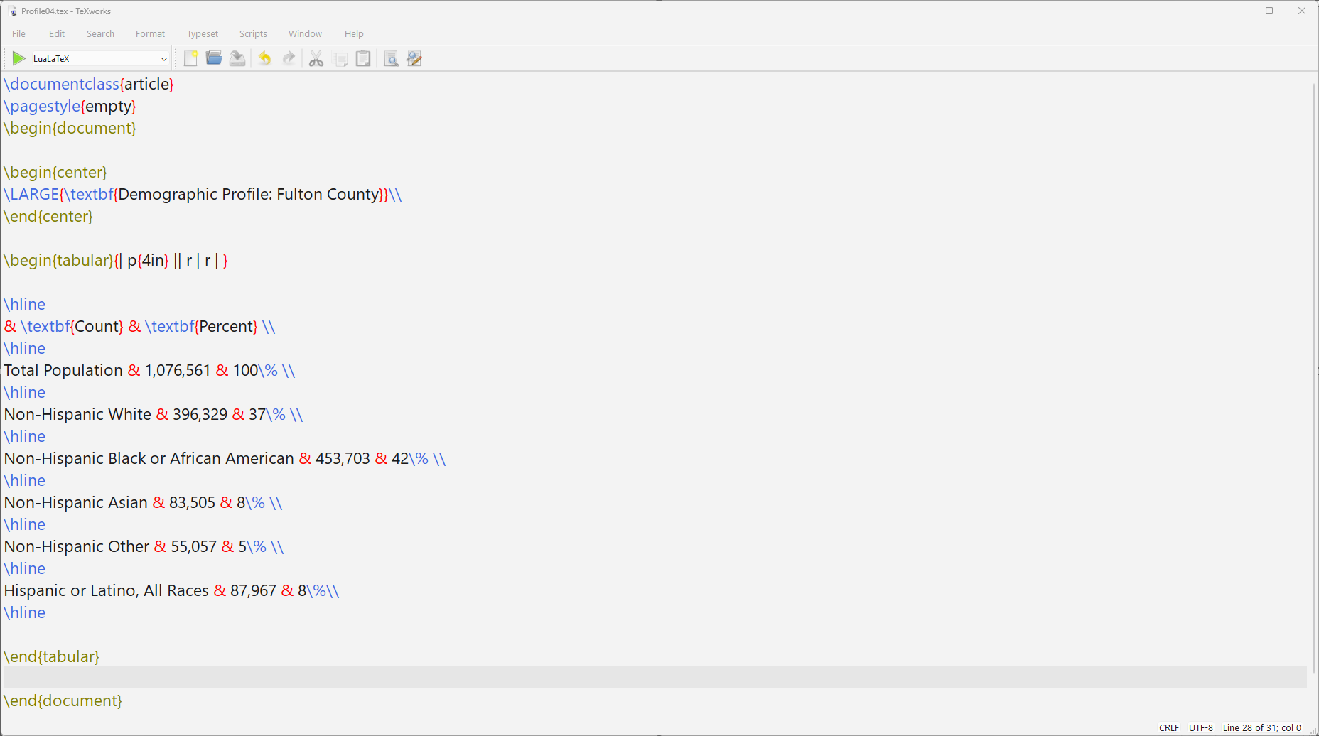
Notes:
Maybe you want gridlines in your table?
We define vertical lines when defining the columns. The Pipe character says where to put the vertical lines (and you can have more than one pipe if you want double or triple lines).
Again, the whitespace here isn't needed-- it's just there to make it easier to see.
Then the horizontal lines are added where desired with the \hline command.
I asked for a double vertical between the category and the data columns

Slide 40
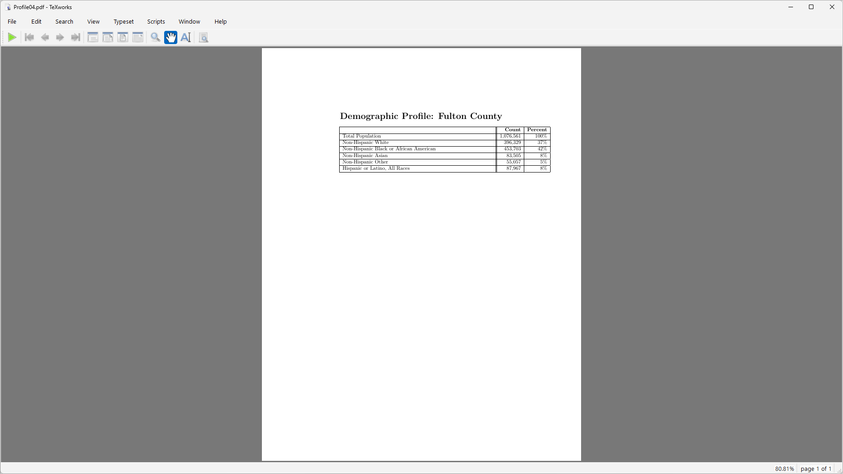
Notes:
…and that's what we got.

Slide 41
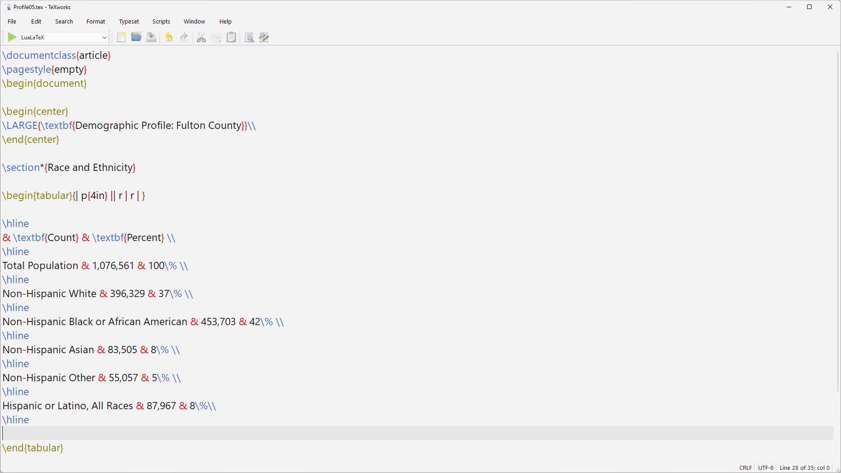
Notes:
We’re going to add more content, so it would be helpful to have section headings before each item, like this Race & Ethnicity heading before the table.
I’m using the starred version of the command (the asterisk after the word section), because that version suppresses the section numbering.

Slide 42
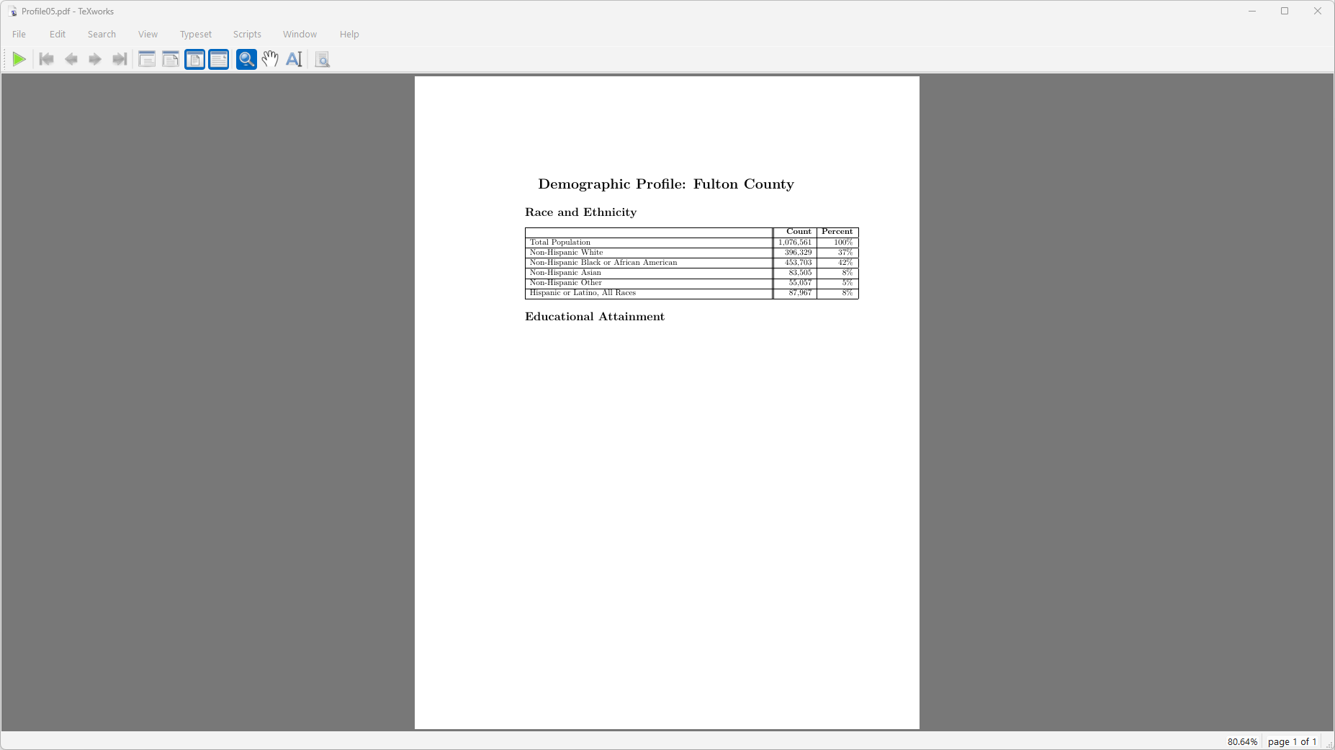
Notes:
Now you may have noticed that things look a little askew. That’s because the article class has VERY generous margins (like you’ll see in many typical journal articles), and the table is poking into the right margin.
Let’s change the margins to be 1” all around.

Slide 43
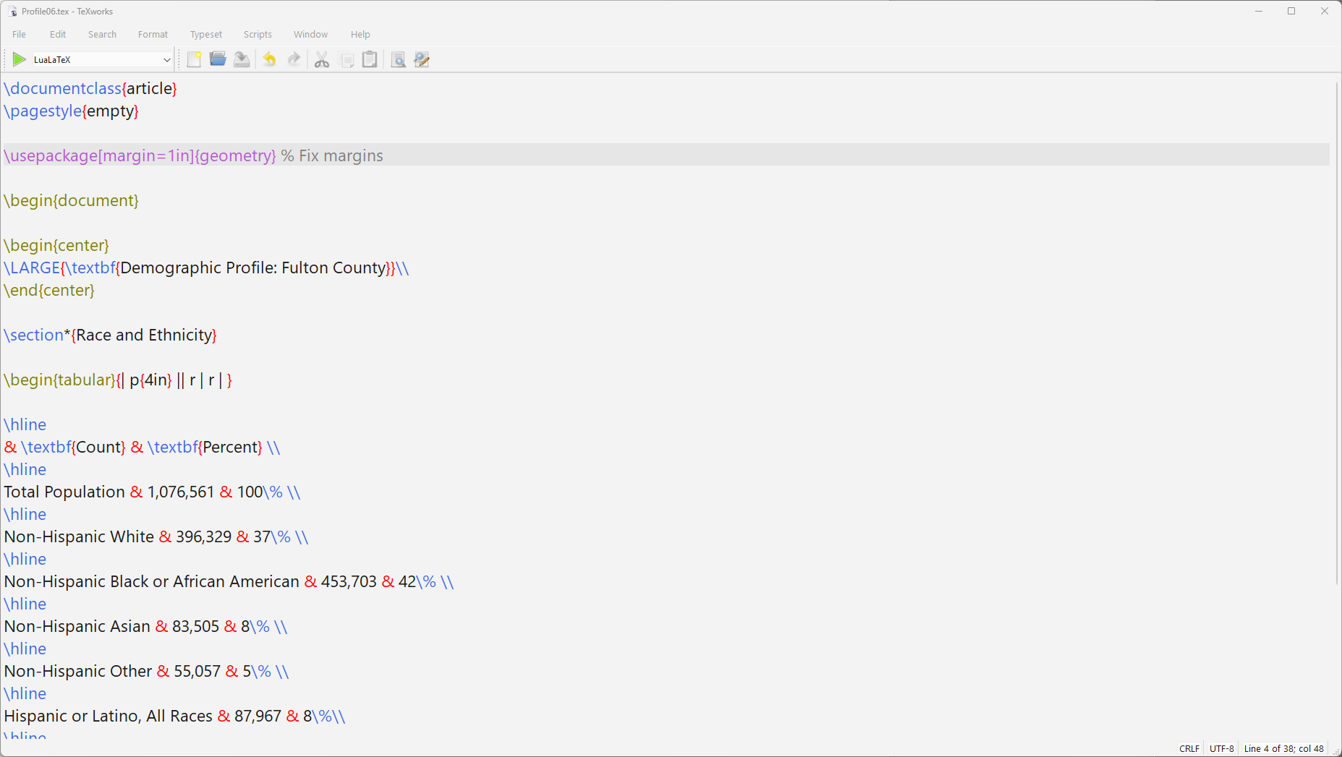
Notes:
To accomplish this, we’ll add our first package to the preamble. The geometry package allows you to have very fine control over margins, binding offsets, and such like.

Slide 44
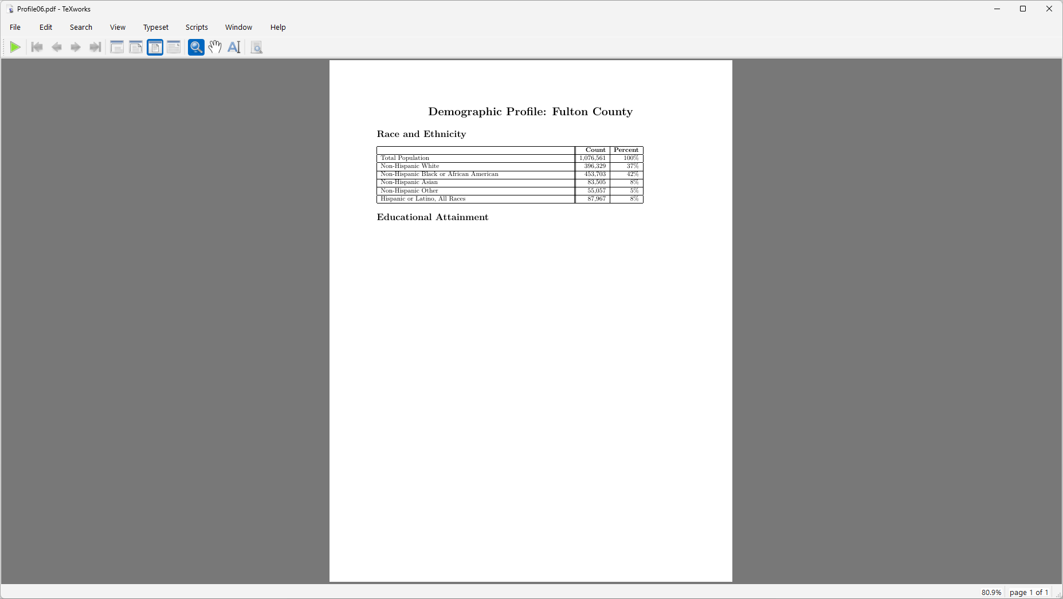
Notes:
Much better.
Let’s add more content. For educational attainment, let’s do a pie chart. To do this, we need to add another package to the preamble.

Slide 45
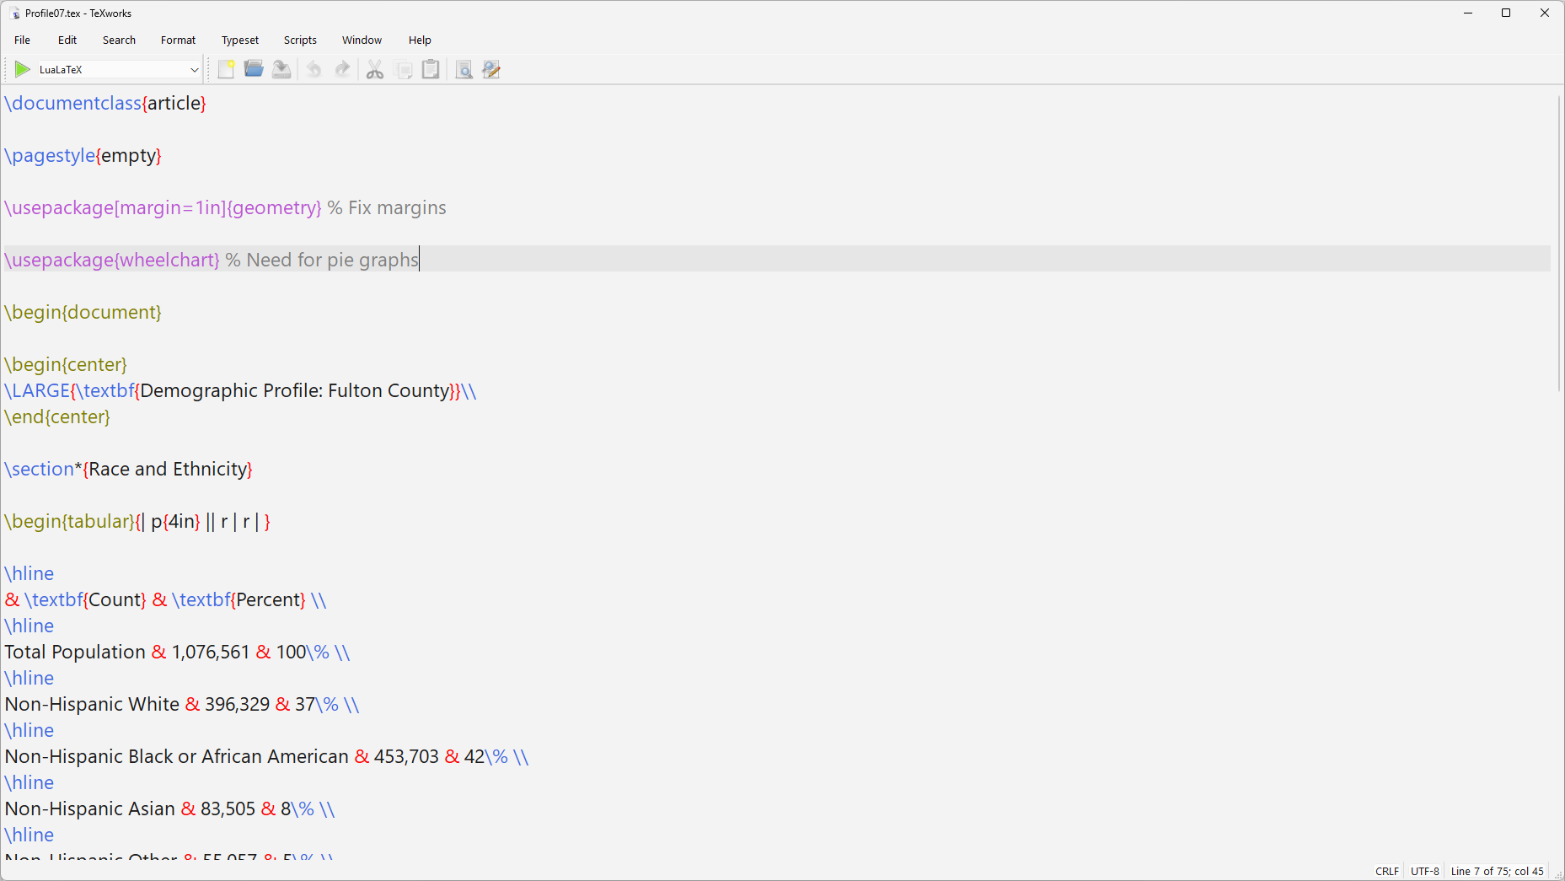
Notes:
The wheelchart package supports pie graphs, donut graph

Slide 46
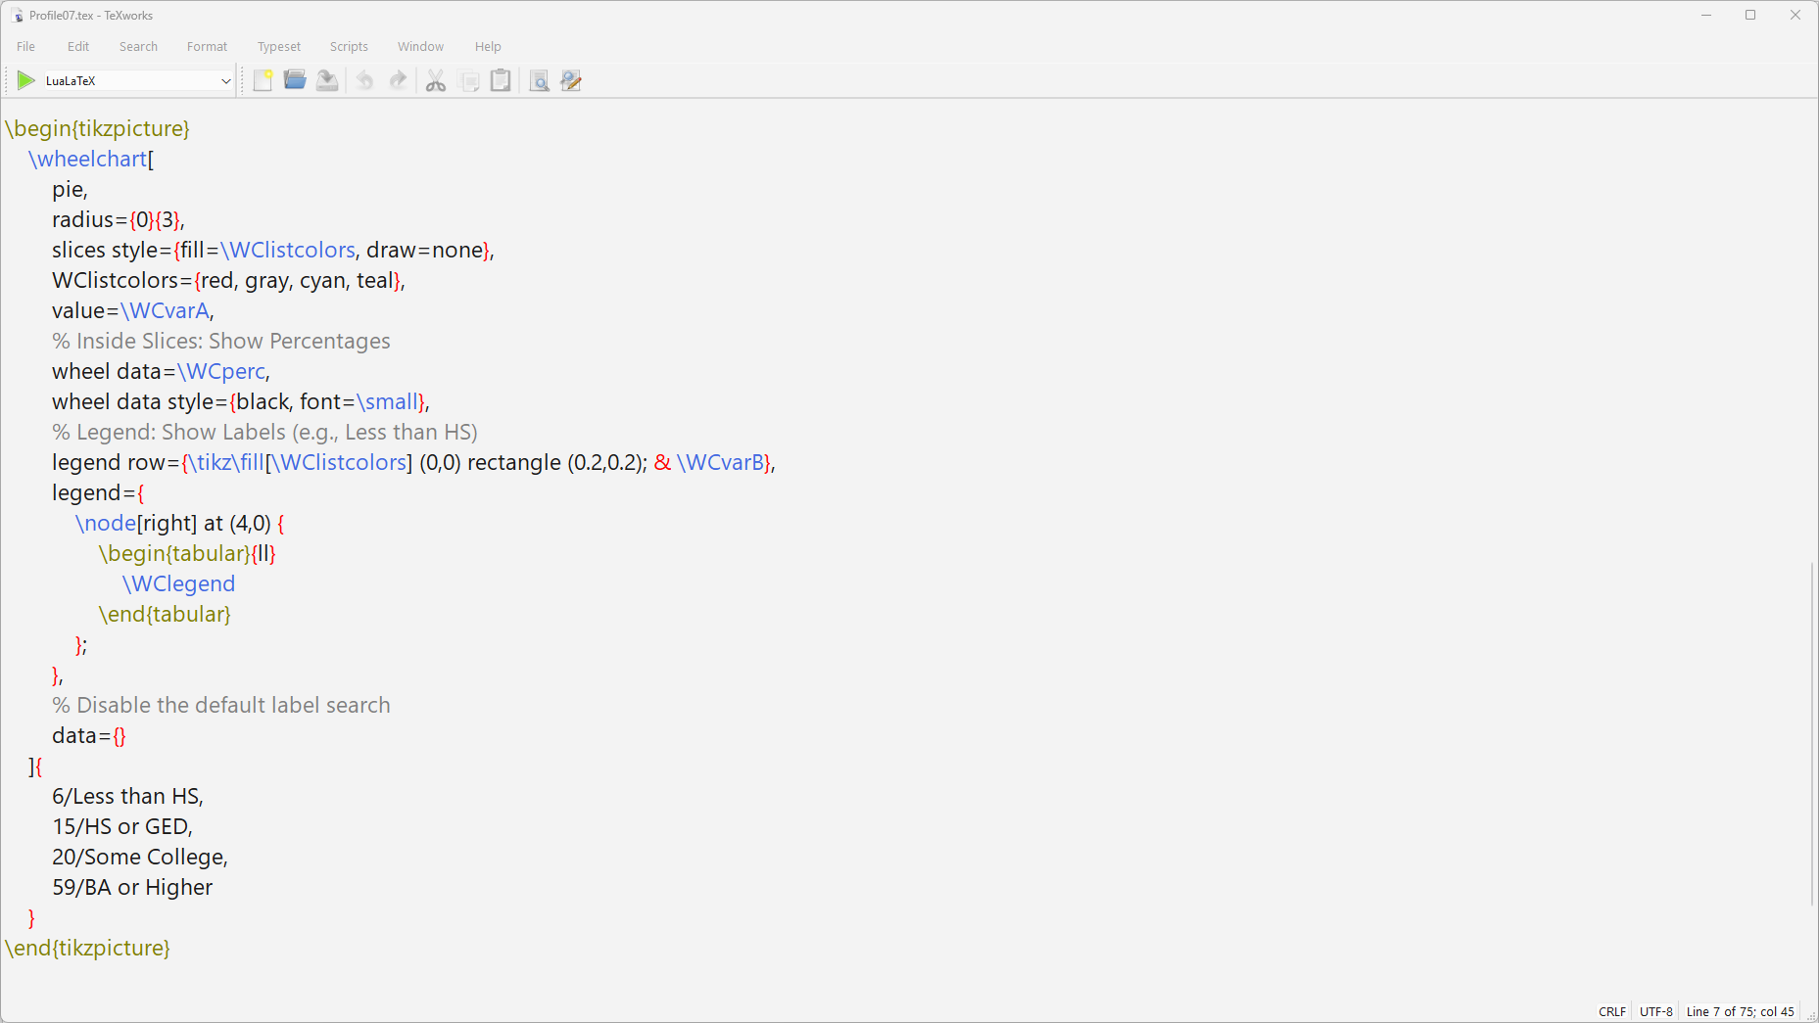
Notes:
The chart syntax is a bit arcane, unfortunately. But you can see that we define colors for the slices (we’re using built-in colors for now), and we tell it things like where to put labels, and legends, the font size and color to use, and the categories and proportions.
The whole thing goes inside a tikzpicture environment because wheelchart is leveraging the tikz vector graphic drawing package.

Slide 47
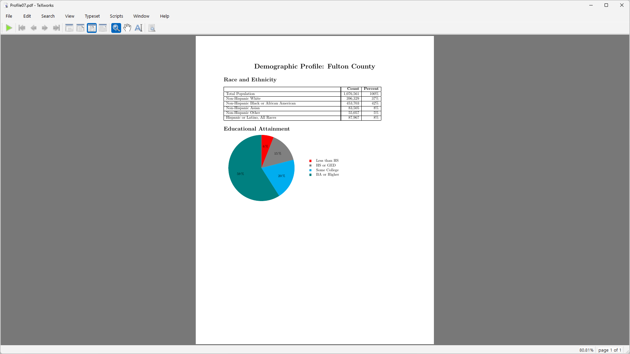
Notes:
And that’s how the pie renders, given the command I provided.
Let’s add another section to our factsheet, maybe a bar graph comparing cost burdened households by tenure (owners vs. renters) for the county vs. the state as a whole.

Slide 48
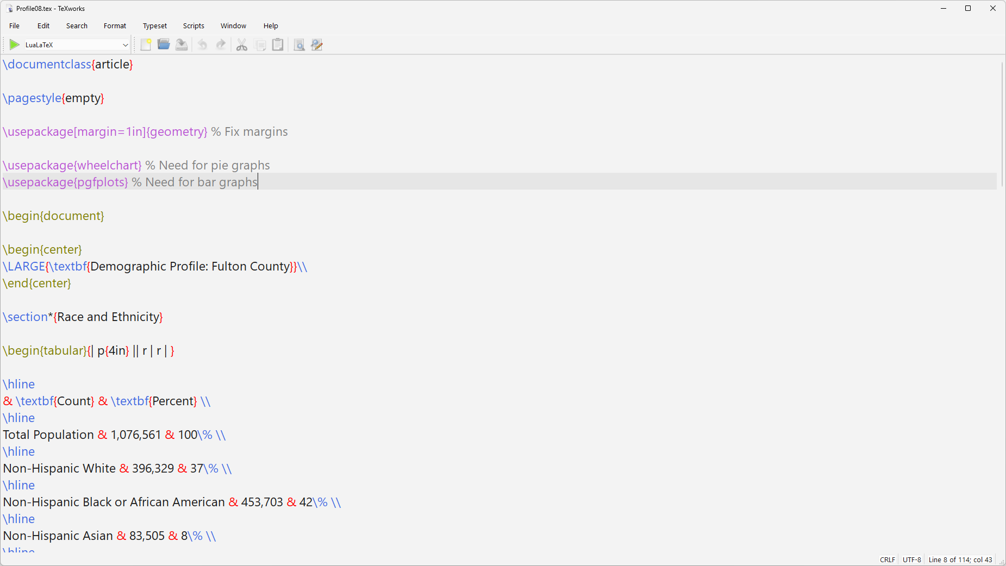
Notes:
So we’ll need to add another package to facilitate creation of bar graphs, namely pgfplots.

Slide 49
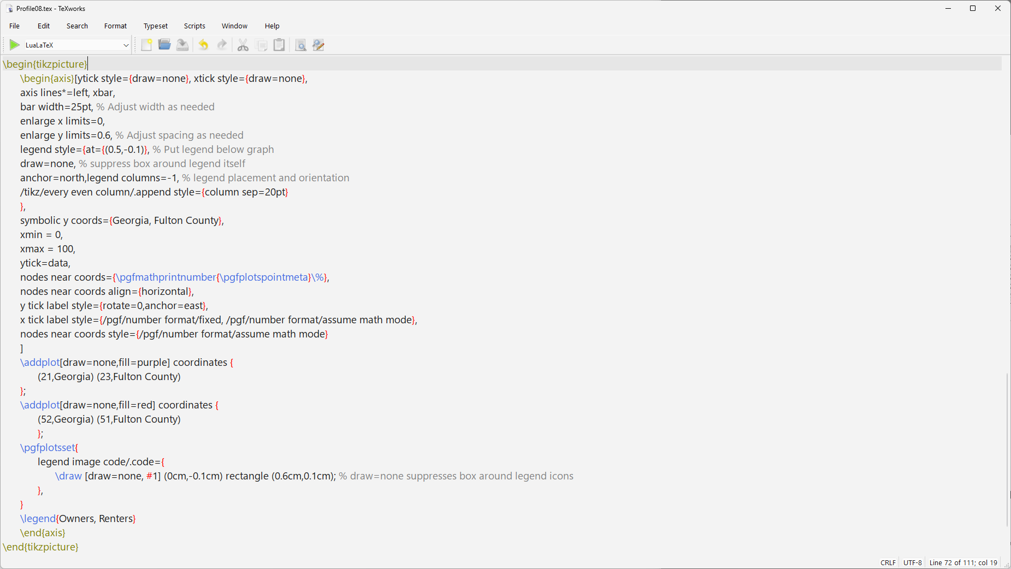
Notes:
This package also builds on tikz. Again, a bit arcane. Most of the code is defining the axes. Then the bars themselves are created via the addplot lines.

Slide 50
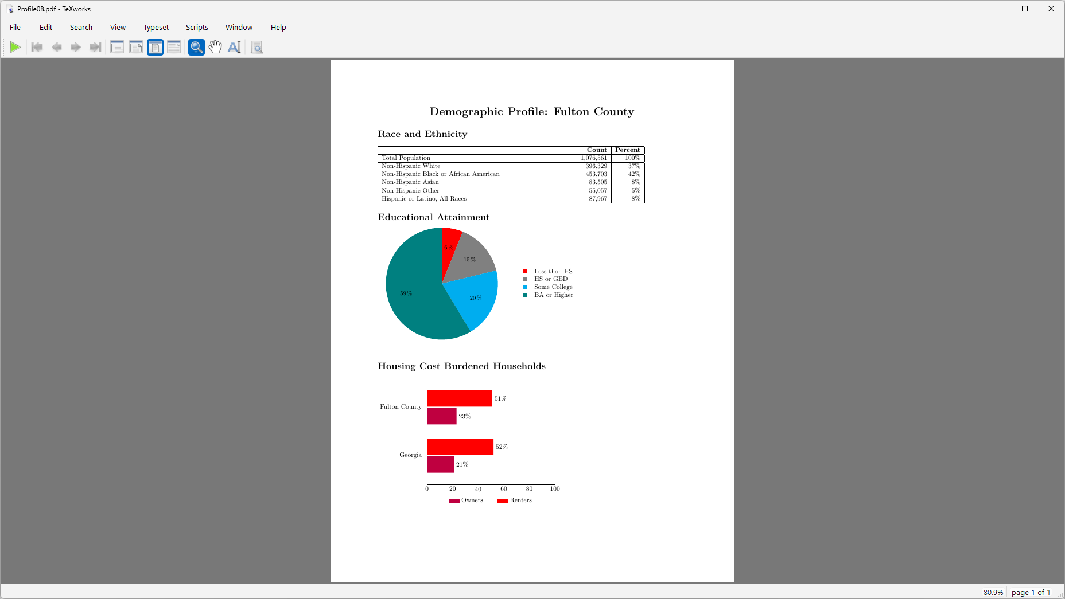
Notes:
And that’s how the graph we defined comes out. Again, we’re using built-in colors and the default font.

Slide 51
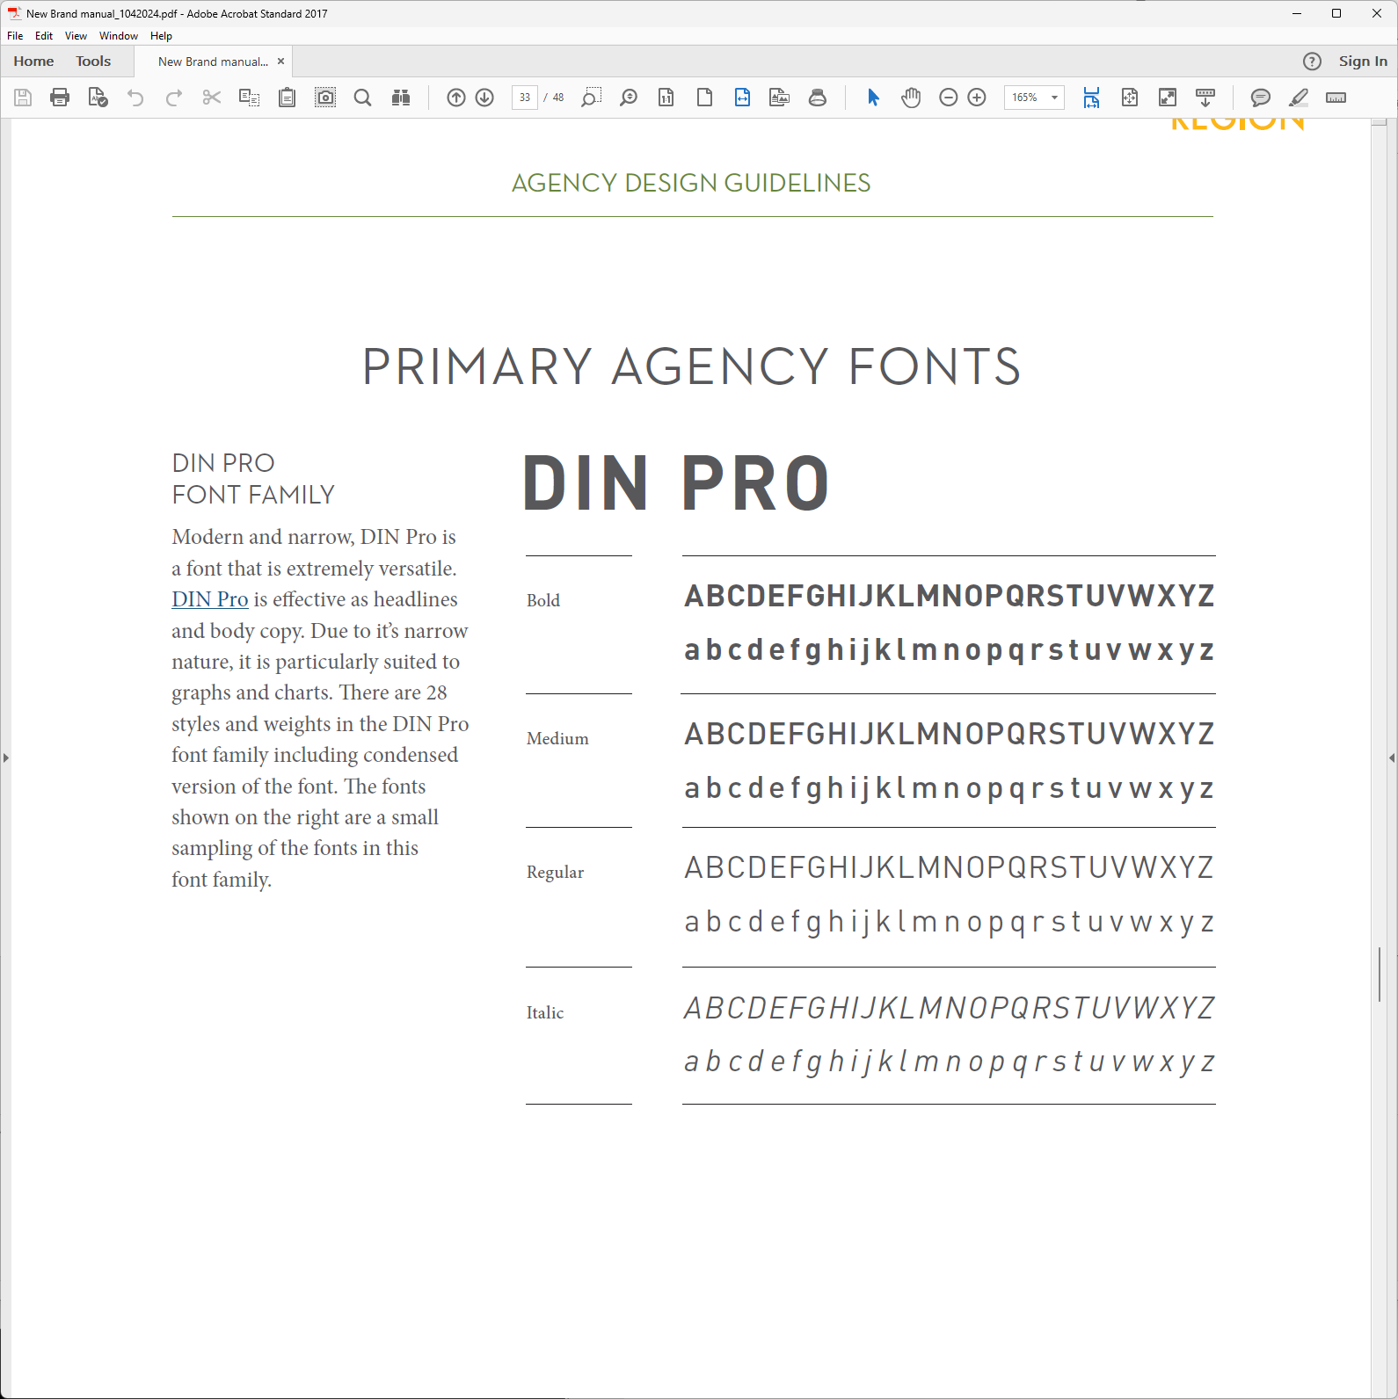
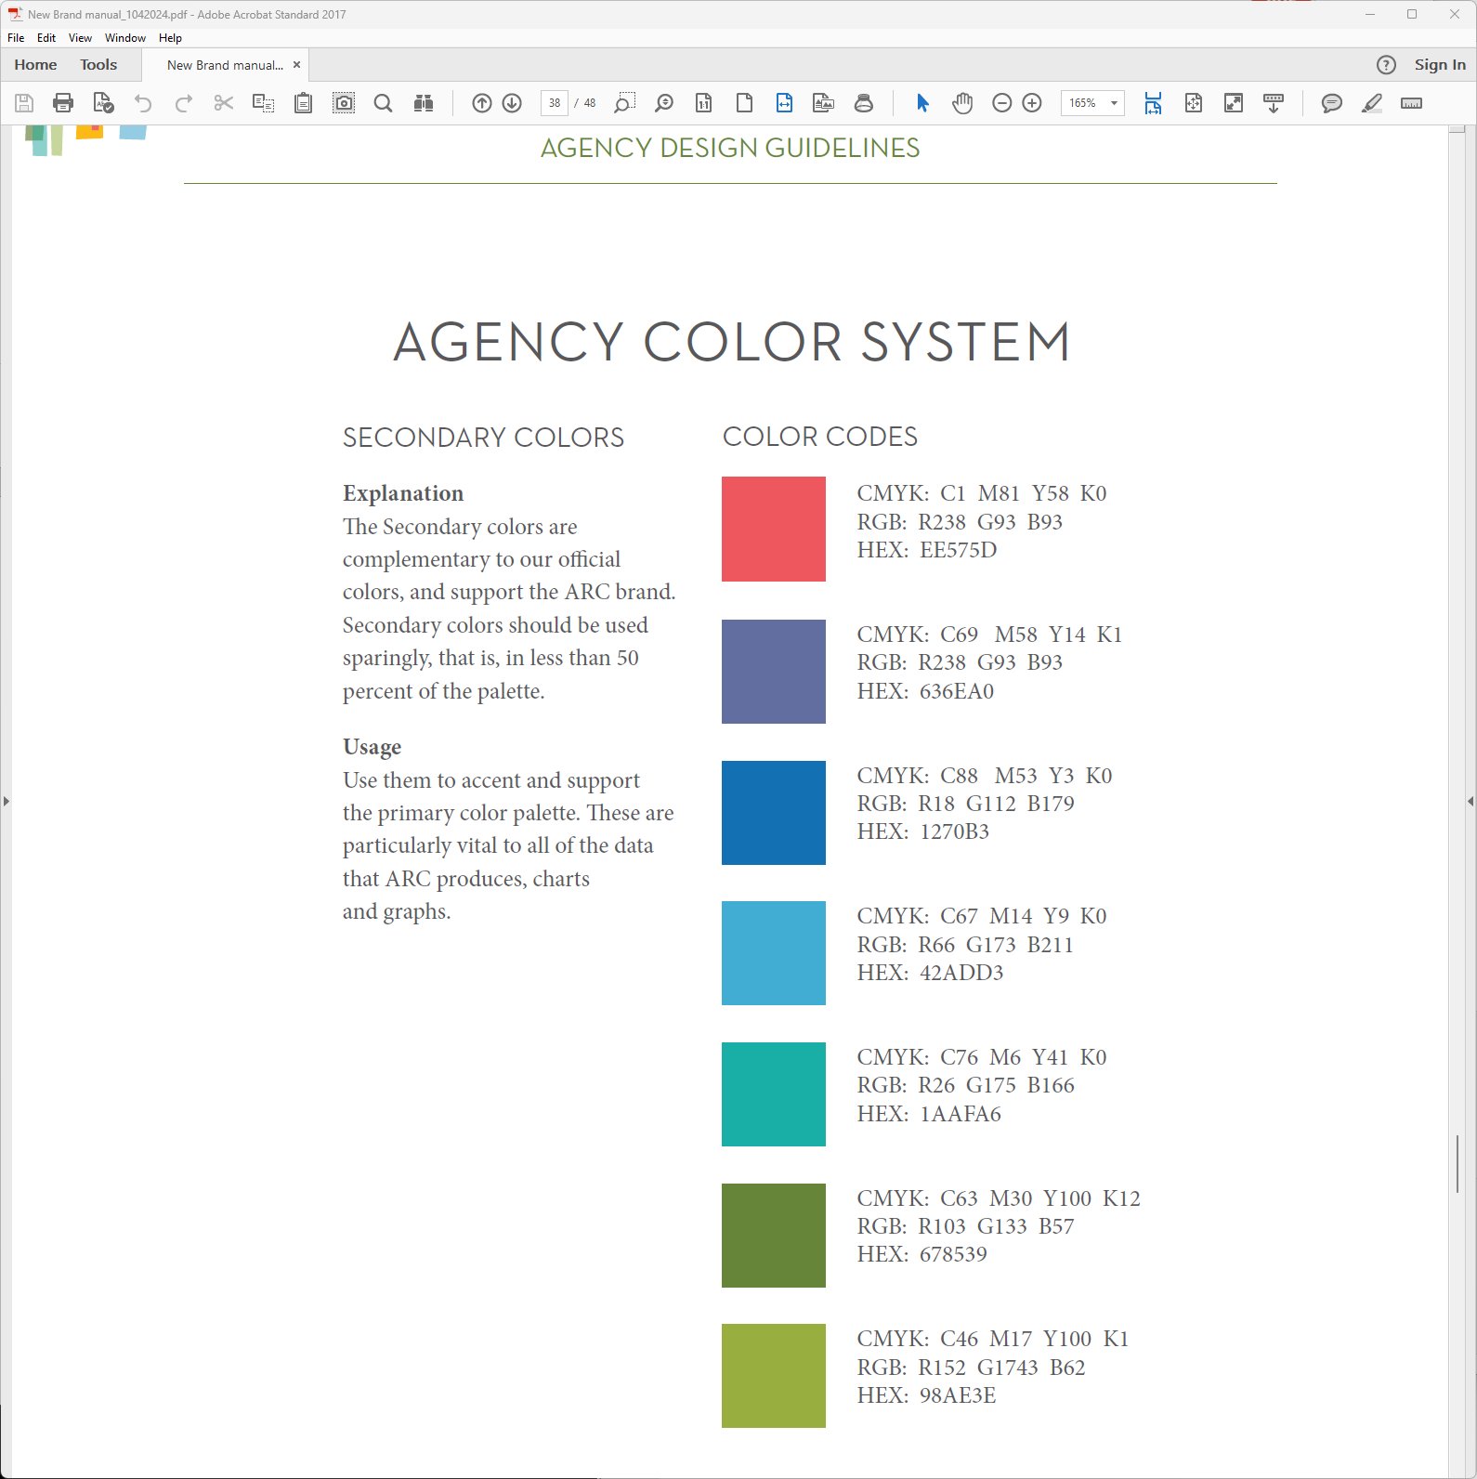
Notes:
But I’m willing to bet that your organization, like ours, has a style guide that you’re expected to follow. We can instruct the LaTeX compiler to use custom colors and fonts.
We just need (you guessed it) more packages.

Slide 52
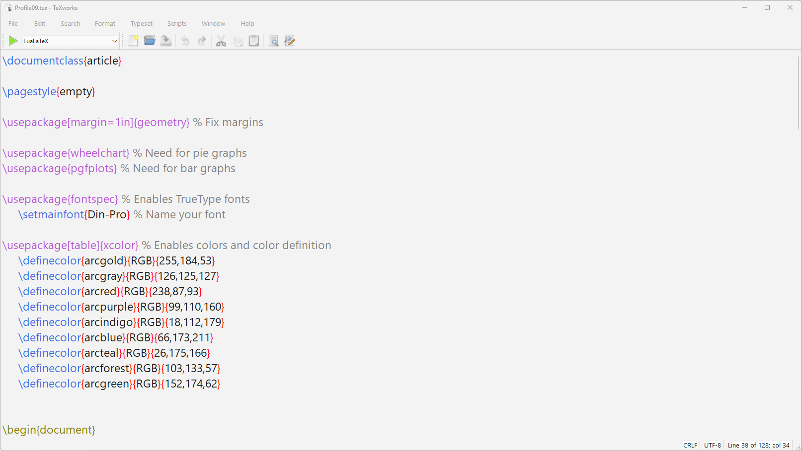
Notes:
The fontspec package allows us to use TrueType fonts, such as the Din Pro installed on my computer.
The xcolor package allows me to define special ARC colors, like the official ARC red. I’m using the RGB definition, but I could have put HTML in the curly braces and then used the Hex value instead. Xcolor also supports CMYK and some other color models.

Slide 53
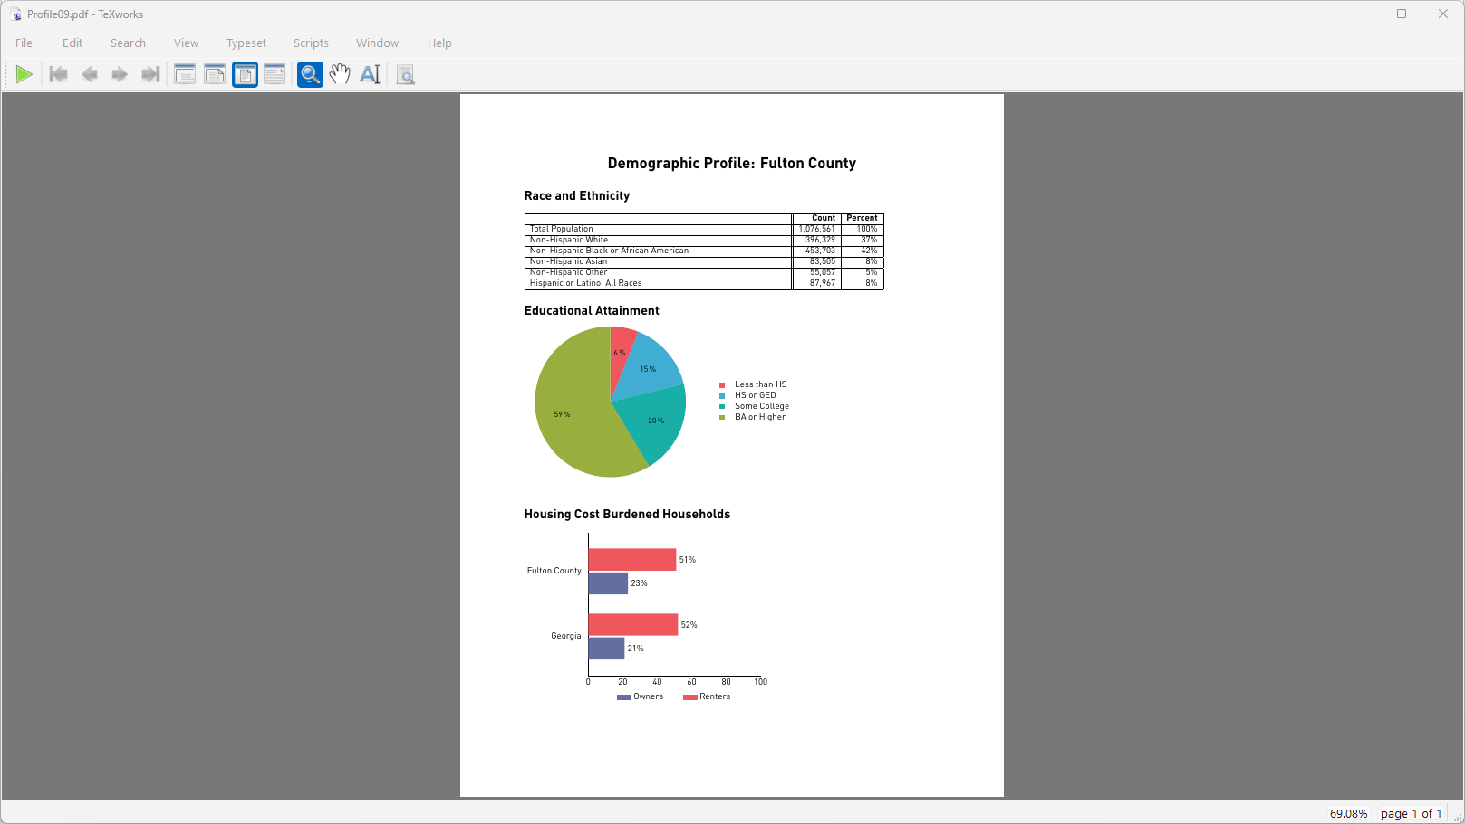
Notes:
I substitute official ARC colors for the default colors I used previously, and now everything is in compliance with agency standards.

Slide 54
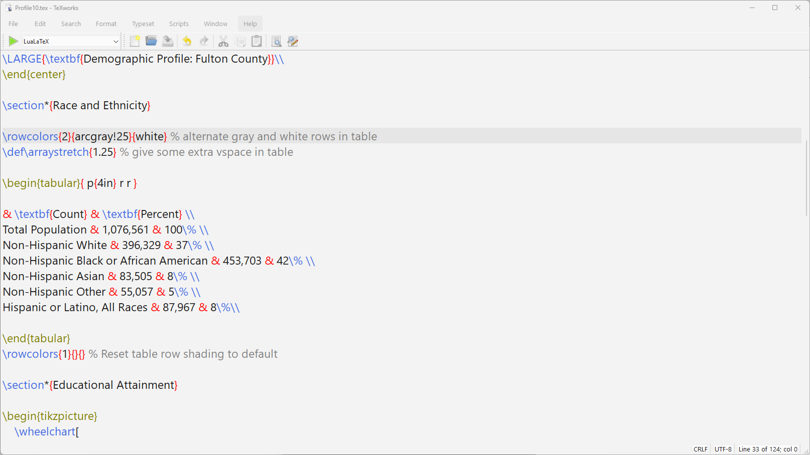
Notes:
Now that we have our colors defined, I can pretty up the table a bit.
I removed all the vertical lines between columns and the rules between the table rows
I’m asking instead for the rows to alternate gray and white– and the gray is a 25% saturation of the official ARC gray.
I also asked for some extra vertical spacing in the table (25% extra to be precise).
And after the \end{tabular} statement, note that I reset the table row shading to the default. Why did I do that? The piechart’s legend is also a table, and I don’t want the alternating shading to propagate to the legend.

Slide 55
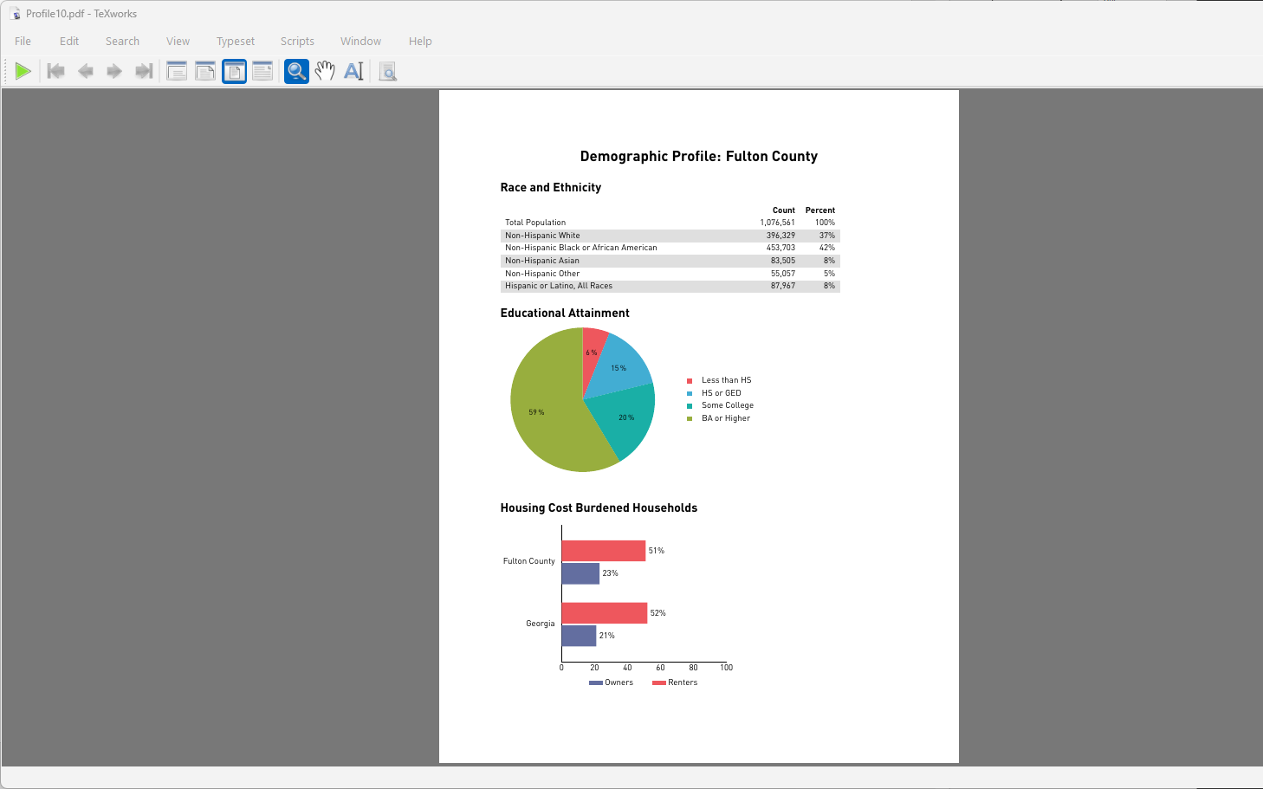
Notes:
This is shaping up nicely. But maybe we’d like to have the “Demographic Profile” text serve as a header at the top of every page? And what if we could have our agency logo print on the bottom of every page? And maybe the logo could be clickable and open up our agency webpage? And what if the section headings could also serve as bookmarks in the final PDF?
Guess what: four more packages!

Slide 56
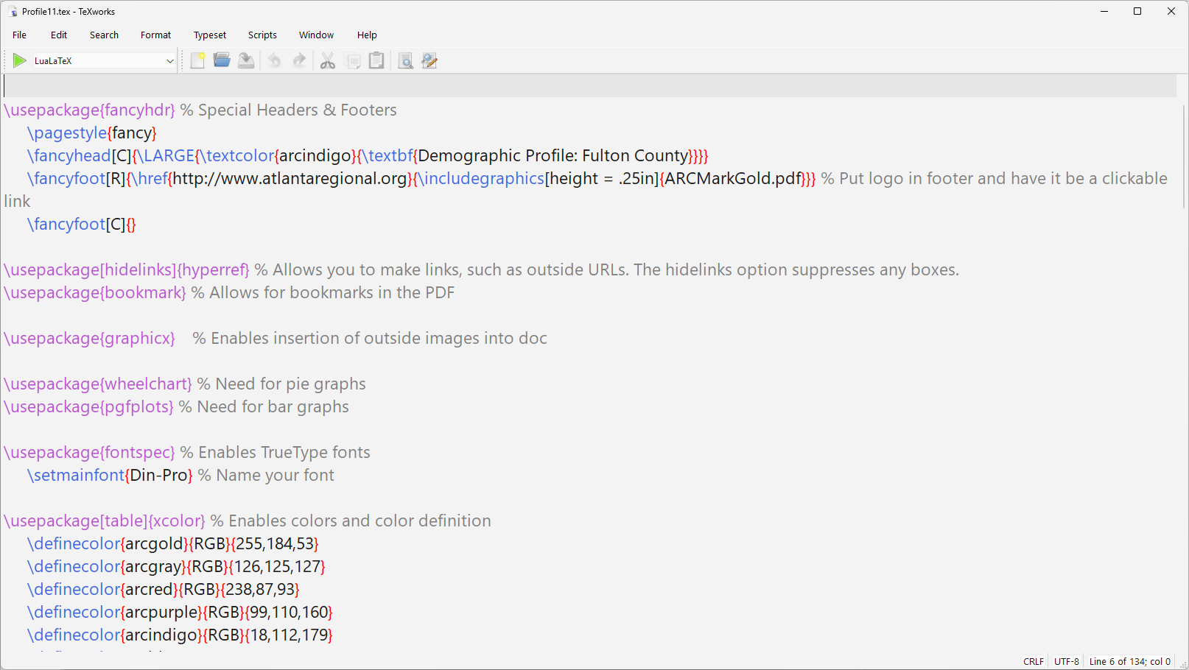
Notes:
The fancyheader package lets us define special headers and footers. The header will have the “Demographic Profile” heading in large indigo colored text. The footer will have our agency logo as a clickable link (courtesy of the href) in the lower right.
And to suppress page numbers, which would appear bottom center by default, I defined an empty center footer.
The hyperref packge allows the hyperlink; the bookmark packages allows for bookmarks, and the graphic package allows me to insert the ARC logo as an image. Note that I have the ARC logo scale so that it will be ¼” tall.

Slide 57
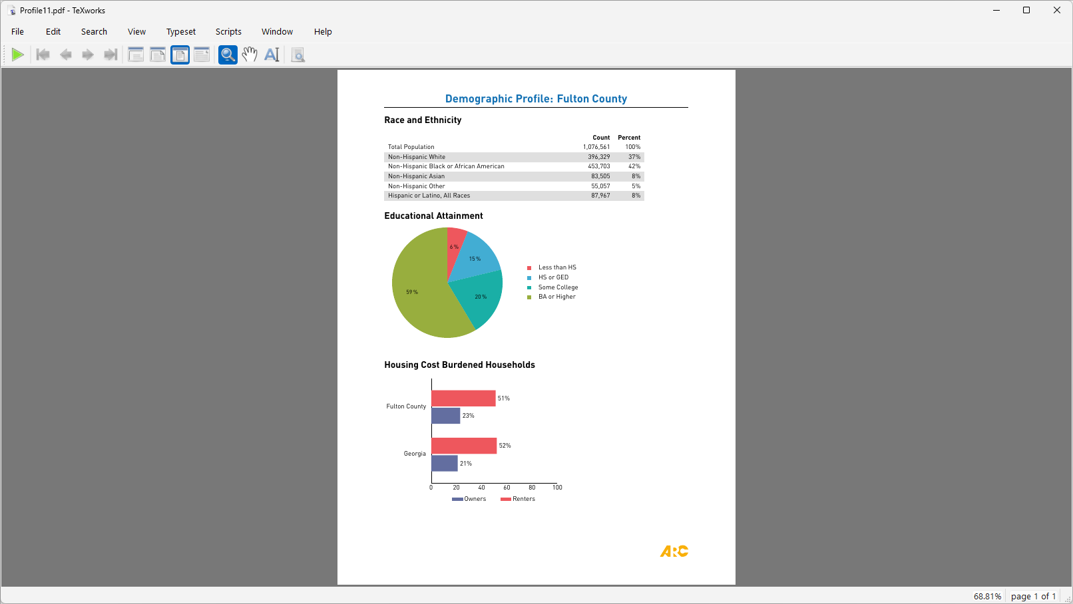
Notes:
So now we have our headers and footers. And were you to click on the ARC logo, you’d have our website open in a browser
One last enhancement: I’d like to have the section headings match the header in terms of color.

Slide 58
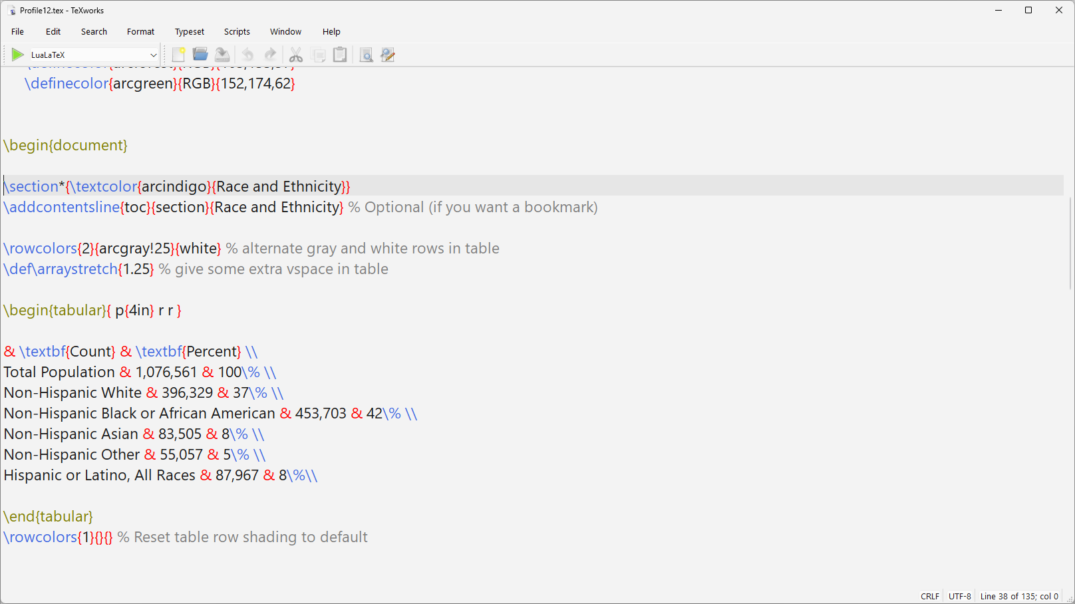
Notes:
We accomplish this by adding a textcolor command to the section heading.
Below that, you see “addcontentsline”. We need that because the starred version of the section headers suppresses not just the numbering, but it also suppresses bookmarks.

Slide 59

Notes:
And there’s our sample factsheet. We could continue to enhance the design, but then I wouldn’t have time to demo the good part– the automation.
I promised to show applications using platforms other than Stata, so we’ll do an example in Python.
Again, this will move quickly, but rest assured that the code we’re about to look at is in the repository for you to inspect further.

Slide 60
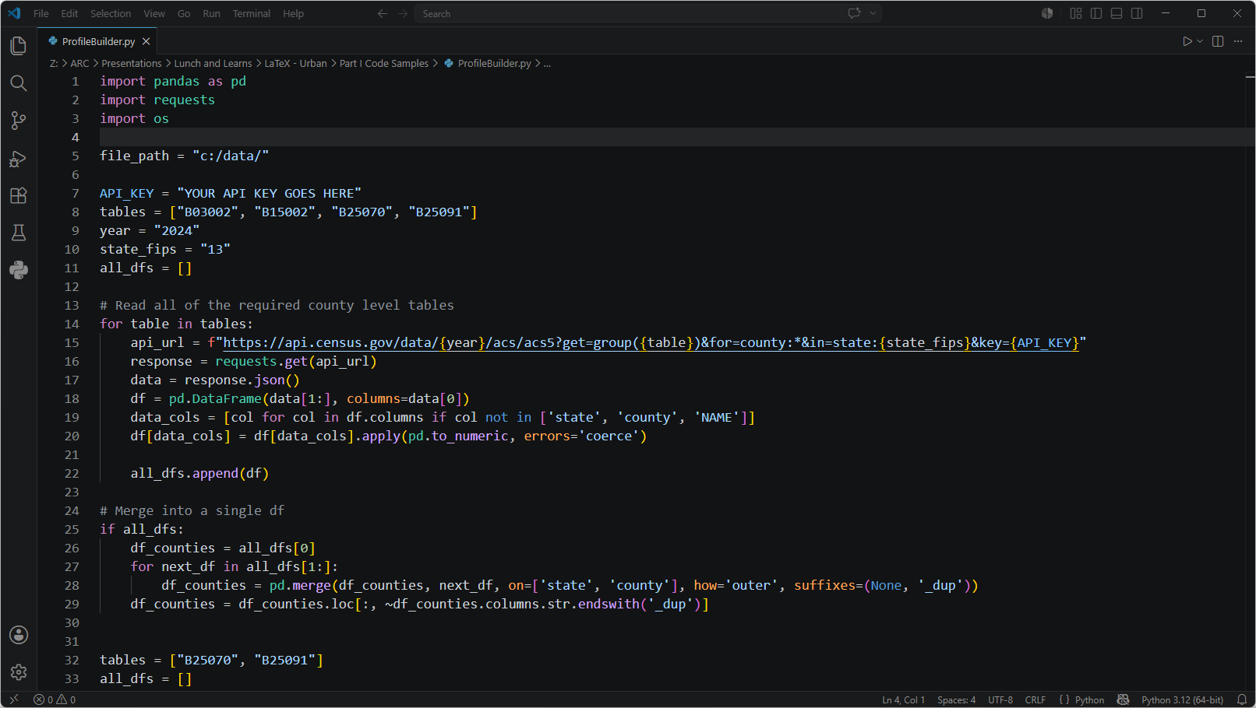
Notes:
Since we want to put geography specific data into each report, the first step is to assemble these data.
We’ll get the data from the Census Bureau via a series of API calls. Our data profile needs four tables: B03002 (race x ethnicity); B15002 (educational attainment); and B25070 and B25091 (cost burden for renters and owners)
The Census Bureau is now requiring API keys for all API calls, so you’ll need to get your own key to put in on line 7. We request each table (in my example for all counties in Georgia), then sew them up together into one master counties dataframe.
The Census API doesn’t support a group call for more than one table, so we loop through the list of tables that I defined in line 8.
You see down at line 32 I have a shorter list of just two tables; we need the cost burden tables for the state as well in order to make the comparisons. Same basic process.

Slide 61

Notes:
The next step is to calculate the actual data columns we need within the dataframe: for example, line 72 defines my percent high school column (pHS) as the number of males who graduated high school (and went no further) plus the number of females who did the same, divided by the total population ages 25 and over– the universe for table B15002.

Slide 62

Notes:
So now we have the data pulled from Census and the required indicators are all calculated.
For the next step, we loop through the rows of our counties dataframe and write the LaTeX code needed to generate each profile. We’re basically just programming a giant mailmerge!
Line 132 opens a file for writing using the file handle latex_file. The subsequent lines just write the contents of the LaTeX file we designed line by line to this new file.
Note that in lines like 143 we take advantage of the magic of f-strings to write the pieces of data unique to that particular county to the file (in this case the name)

Slide 63

Notes:
Same deal here in lines 182-187 where we write the population counts and percent for each racial or ethnic group for the applicable county.
The f in f-string stands for formatted so, we can specify how we want numbers to be formatted.
I’m asking for the population counts to be formatted with commas separating thousands, and for percents to be rounded to zero decimals. You can change this to taste.

Slide 64

Notes:
And then when we’re done writing the all of our code, line 273 closes the LaTeX document.
Lines 275 till the end invokes LuaLaTeX to compile the LaTeX code to a PDF, and then do some cleanup by deleting the intermediate files that get created along the process.

Slide 65

Notes:
The end result is 159 PDF documents, one for each of Georgia’s counties that follow the template we designed. And note the bookmarks that we defined.

Slide 66
Structure of the Talk
Unit 1: Basics
What is ?
How do I use it?
Sample profile design workflow
Unit 2: Deeper Dive
Preamble
Structure
Text sizes & styles
Environments
Lengths
Spacing
Unit 3: LaTable: a Stata table generator for data factsheets
Notes:
That concludes the first unit. And this is a great time to drop off if you were curious but aren’t ready to implement what we just went over.
The next unit will get a bit more in the weeds of LaTeX to help you build a document as a prelude to understanding how the table generator I wrote can be used.

Slide 67
Quick Review of
Markup language for typesetting
Commands
\command[options]{required stuff}
\command*[options]{required stuff}
File consists of:
Preamble
Class of document {required!}
Attributes such as author
Load packages
Define commands, colors, etc.
Document itself
\begin{document}
\end{document}
Notes:
Just a quick review before we take a deeper dive:

Slide 68
Quick Review of
Reserved Characters:
\ Starts command [\textbackslash]
{ and } Start/end command argument
& Alignment character (primarily for tables)
% Starts comment
$ Starts/ends math mode
_ and ^ Superscripts and subscripts in math mode
# Arguments in macro
~ Non-breakable space (similar to &nbsp; in HTML)
Notes:
As I mentioned earlier, LaTeX uses certain characters for special purposes. You’ll need to escape these with a backslash if you want the character itself.
Special case: the backslash itself can’t be escaped because, as you probably already noticed a double backslash ends paragraphs and table rows.
So there’s a special textbackslash command to produce the backslash character.

Slide 69
: Deeper Dive – The Preamble
\documentclass[options]{classname}
Built-in document classes:
article - journal article (but also good default)
report - intermediate between article and book
book - full length book (chapters, appendices)
letter - includes option for mailing labels
slides - slides (but not as good as beamer!)
Commonly used custom classes:
beamer - slides
cvmodern - resume/CV
Notes:
Returning to the preamble, the document class is a required element (and as I mentioned before, the only required element), and determines the base layout of the document: font, base font size, etc.
Here are come useful ones:

Slide 70
: Deeper Dive – The Preamble
\documentclass[options]{classname}
base typeface size: 10pt, 11pt, 12pt
paper size: a4paper, a5paper, b5paper, executivepaper, legalpaper, letterpaper
draft or final: draft, final
orientation: landscape
title page: titlepage or notitlepage
onecolumn, twocolumn
oneside, twoside
Notes:
Some of the options that you can set include the base typeface size, paper size, orientation, and so on.
The dafting mode helps you spot formatting issues
Oneside vs. twoside matters if you’re creating a document to be bound.

Slide 71
: Deeper Dive – The Preamble
\pagenumbering{}
arabic
roman
Alph
alph
gobble (suppresses page numbers; incompatible with hyperref)
\pagestyle{}
plain
empty
headings
In document, use \thispagestyle{} to change style for current page
Notes:
Page numbering lets you set what type of numbers
Page style lets you change headers and footers (but the fancyheader package lets you do still more)

Slide 72
: Deeper Dive – The Preamble
Optional attributes:
\title{}
\author{}
\thanks{}
\date{}
In document:
\maketitle{}
Notes:
You can embed things like the title and author in the preamble and have those items appear on title pages, etc.

Slide 73
: Deeper Dive – The Preamble
\usepackage[options] {packagename}
geometry: control paper size, margins
fontspec: use TrueType fonts
fancyhdr: customize headers and footers
xcolor: colors in document
hyperref: hyperlinks in document
endnote: endnotes instead of footnotes
graphicx: import images
pifont, marvosym, wasysym, tikzsymbols, and fontawesome: special symbols
multirow, multicol, longtable, booktabs, colortbl: more control of tables
tcolorbox, fancybox: fancy boxes
hyphenat: control hyphenation
tikz, pgfplotstable, pgf-pie, wheelchart, sparklines: make charts and drawings
stackengine : overlap images
hanging: hanging indents for paragraphs
adjustbox: scaling of figure or plot
amsmath, amssymb: formatting of mathematics
Notes:
And then there are the packages. Here’s a list of some useful ones and what each one does.

Slide 74

: Deeper Dive – The Preamble
\usepackage {fontawesome}
Notes:
For example, fontawesome lets you include special symbols in your doc.

Slide 75

: Deeper Dive – The Preamble
\usepackage {tcolorbox}
\usepackage{graphicx}
\usepackage{endnote}
Notes:
A few of these that are Especially useful include tcolorbox, which is responsible for the green box, the blue box, and then the colored bars marking each section in our data profiles.
The graphic package we saw earlier; it allows me to include the ARC logo and also the locator maps that exist as external files.
And the endnote package allows me to have endnotes with all of my data sources.

Slide 76


: Deeper Dive – The Preamble
www.ctan.org
Notes:
R users know CRAN --- The Comprehensive R Archive Network
Python users use PyPI (Python Package Index)
Similarly, LaTeX has CTAN = Comprehensive TeX Archive Network
Over 6,600 packages, all kinds of stuff. Even packages for typesetting chessboards and musical scores

Slide 77

: Deeper Dive
https://tug.ctan.org/info/symbols/comprehensive/symbols-letter.pdf
Notes:
Need special symbols? They’ve got you covered with a comprehensive list.

Slide 78

: Deeper Dive – Structure
Sectioning
Starred version of command suppresses numbering
Notes:
We talked a bit about sectioning earlier, but here’s a list of the various levels. Not all levels exist for all document types

Slide 79

: Deeper Dive – Text size and style
Text sizes are relative to base font size:
Notes:
And we made some large text during our examples- here is a list of available text size commands. As you can see, it is all relative to the base font size.
There are additional packages that provide yet more options for font size.

Slide 80

: Deeper Dive– Text size and style
Text styles can be implemented as a command or a declaration:
Notes:
And then we have various text styles available

Slide 81
: Deeper Dive– Environments
\begin{environment name}
\end{environment name}
tabular: tables
enumerate: numbered list
itemize: bulletized list
description: list of labeled items
flushleft, flushright, center: justification
quotation, quote: quotations
verse: poetry
abstract: article abstract
equation: number equation
figure: number, caption figures
letter: creating letters
minipage: invisible box around objects
picture: simple drawings
verbatim, verb: verbatim text
footnote, endnote: footnotes and endnotes
Notes:
I’ve mentioned environments before, but here’s a more formal definition:
LaTeX environments apply specific typesetting effect(s) to a section of your document based on the type of content.
Here’s a list of some popular environments.

Slide 82

Item
Description
Notes:
For example, a description environment has items and corresponding descriptions

Slide 83

Notes:
Here’s how those pairs render.

Slide 84

Notes:
You can change the justification of text (left, right, center….) through environments

Slide 85

Notes:
Like so.

Slide 86

Notes:
Block quotes are handled in the quote environment

Slide 87

Notes:
And render like this.

Slide 88

Notes:
Similarly, the verse environment

Slide 89

Notes:
Is good for typesetting poetry.

Slide 90
: Deeper Dive– Lengths
\setlength{\thing_getting_set}{amount}
\parindent: amount each paragraph is indented
\baselineskip: spacing between lines in paragraph
\parskip: spacing between paragraphs
\arraystretch: buffer between table rows
\tabcolsep: buffer between table columns
\columnsep: buffer between columns of text (multicol doc)
\columnseprule: width rule between columns of text
Notes:
Lengths are related to spacing. The general format is:

Slide 91
: Deeper Dive– Lengths
\setlength{\thing_getting_set}{amount}
Unit | Name | Description
pt | Point | 1/72.27”
pc | Pica | 12 pt
In | Inch
bp | Big Point | 1/72”
mm | Millimeter
cm | Centimeter
ex | ex | Approximately the height of the lower case x in the current font
em | em | Approximately the width of upper case M in the current font
Notes:
Length amounts can be defined in a lot of different ways: points, picas, imperial units, metric units, even typeface dependent units.

Slide 92
: Deeper Dive– Spacing
\vspace{amount}
\hspace{amount}
\enspace (1/2 em)
\quad (1 em)
\qquad (2 em)
\hfill (stretch as needed to fill line)
\hrulefill (hfill but with a line filling the space)
\dotfill (hfill but with dots filling the space)
Notes:
You can add vertical or horizontal space with various commands:

Slide 93

Notes:
And here’s an illustration between hfill, hrulefill, and dotfill:

Slide 94

Notes:
And how each renders

Slide 95

Notes:
Last thing I’ll address is footnotes and endnotes.
Footnotes are built in to LaTeX, while endnotes require adding the endnotes package to your preamble. They operate the same, except for where the actual note appears.
In both cases, you stick the text inside the footnote or endnote environment at the spot where you want the superscripted number to appear. That seems odd until you realize that this is consistent with how all environments work.

Slide 96


Slide 97
Structure of the Talk
Unit 1: Basics
What is ?
How do I use it?
Sample profile design workflow
Unit 2: Deeper Dive
Preamble
Structure
Text sizes & styles
Environments
Lengths
Spacing
Unit 3: LaTable: a Stata table generator for data factsheets
Notes:
We’re switching over to the 3rd unit, so a good place to drop off if you aren’t interested in the Stata specific tool. I that said, I WILL talk a bit about how it works in case you want to build something similar for a different platform.

Slide 98
LaTable
The motivation:
Creating tables of numbers is a PITA
This is especially true when you have to format different numbers differently:
Dollars
Percentages
Comma separated thousands
Different numbers of decimals, e.g.
Census reports median age to 1 decimal
Census reports household size to 2 decimals

Slide 99
LaTable
The solution:
Create a table of tables
LaTable
Reads through the table information
Applies the necessary formatting to numbers
Places code around the numbers to define the table
Requires Stata 16 or higher (June 2019)
Notes:
The solution is to have two dataframes: one with the data, the other with a table of tables that defines how the table should be created.
The LaTable adofile defined a Stata command that reads the table specs
Because you have to have two dataframes in memory, LaTable requires Stata 16 or higher. Prior versions only allowed one dataframe in memory at a time.
Fortunately, we’re now on Stata 19; version 16 came out about seven years ago.

Slide 100
LaTable
What goes into the table of tables?
Each row of definitions corresponds with one row of actual table and is of one of these four types:
Title
Header
Data
Blank (space)

Slide 101
LaTable
TableType
Table category
Table
Table name (how you invoke the table)
Indent
Number of indents (up to 3)
Col1Text
The text that goes in the row
Data1, Data2, Data3, Data4
Variable names (or text for headers if it is a header row)
Sig
Variable name if there is a significance flag
Type1, Type2, Type3, Type4
Data type for Data1-Data4 (Number, Percent, MOE, pMOE, D1, D2, d1MOE, d2MOE, Dollar, DollarMOE)
Notes
Notes Field (e.g., Source)
Notes:
And these are the specifications that go into the table definitions

Slide 102

LaTable
Notes:
Let’s see how this works out in practice: here’s a sample table from the ARC data profiles. Seems simple enough.

Slide 103
LaTable
Column headers
Title
Date
Endnote
Total row
Indentation (to show hierarchy)
Notes:
But there’s actually a fair amount going on here.
Every table needs a title. You might want to let the reader know the date or vintage of your data. You probably want a note about the data source.
Column headers should be clearly marked; You also want the total row (representing the population) to stand out You need to indent some of your categories to show the hierarchy. In this case, Born in the United States is a subset of “Native”, then State of residence and different state are subsets of born in the U.S.
And numbers need to be formatted to specific numbers of decimal places; margins of error need the plus/minus; others need a percent sign (or perhaps a dollar sign)

Slide 104

LaTable
Notes:
That’s where the table specs come in. So here’s what this table’s specifications look like:
First a title row; the content of “notes” will appear in an endnote in the document.
Next the Header row has the column headings that will appear in bold
The third line has the total, which will render in bold. You can follow any naming convention you like, but I have my estimates and margin of error to have the same names except for the suffixes: _e for the estimate and _m for the margin of error
Type 3 (number) tells the routine to report Data3 as an integer with comma separating thousands; Type4 says that Data4 is a margin of error, so add the plus/minus sign.
Rows 4-9 are the remaining data. The indent field specifies the hierarchy; now we also have Type3 contain percent (1 decimal and a percent sign) and pMOE (again 1 decimal and a percent sign PLUS a plus/minus).

Slide 105
LaTable
Path to table templates file
latable using "Z:/LaTeX Tables/ACS 2020-24 Reports/Table Templates.dta", table(PlaceBirth2) rowcolors(nnLtGray white) n(`i') printdate(2020-24)
Name in template file
(optional) interleave
colors
Which observation? (looping through
records)
(optional) Add data dates to table title
Notes:
We generate this table by invoking the latable command. The syntax we pass in the command tells the routine information like:
Where is the table template file located?
What table should be generated from among the templates contained in that file?
Should the rows switch off colors?
We’re looping through records, so passing a macro to say which observation.
And then if you want the year (or some other text added to the title after a comma, then we specify printdate)

Slide 106

LaTable
Notes:
This is the code generated by that one command (with the correct data embedded)

Slide 107
LaTable
Notes:
And that code compiles to create this table.

Slide 108

https://ctdatahaven.org/profiles/connecticut-city-neighborhood-profiles/
Notes:
Finally, I thought it would be nice to do an applied example. I looked who registered for the webinar and poked around on your various websites.
I struck paydirt with DataHaven: they have a nice interactive visualization version of city neighborhood profiles, but no static profiles (at least on that page).
AND they also have a CSV file with neighborhood profile data. So nice raw materials

Slide 109

Notes:
The CSV had about 50 indicators covering six basic topics, so I built a table specs file to cover all of the indicators.
The CSV and this Specs list are in the repository.

Slide 110


Notes:
I was able to harvest some colors from a recent publication, and I found a DataHaven logo online,

Slide 111

Notes:
The City of New Haven has a feature service of neighborhoods on their Open Data Portal…

Slide 112



Notes:
I exported a shapefile of that feature service and then generated inset maps for each of the 19 neighborhoods using two of my harvested colors

Slide 113

PrepDataHaven.do
Notes:
I wrote a .dofile to prep the csv data (also in the repository)

Slide 114

Notes:
Grabbed some text from the DataHaven website about the organization

Slide 115

DataHavenProfiles.do
Notes:
And wrote another dofile to generate and compile the LaTeX code for each neighborhood. Again, this code is in the repository.

Slide 116

Notes:
And the result is 19 profiles, one for each neighborhood.
Start to finish took a couple of hours. If time allowed, I’d want to dork more with the color combinations, but I’m otherwise pretty happy with the result.

Slide 117
GitHub!
https://github.com/arc-moshe/NNIP-LaTeX
This deck
Code samples in the deck
The LaTable ado file (and help file)
Sample project with code
Notes:
And there you have it.
Again, a reminder of how to access all of the materials I presented.

Slide 118
Want to Learn More?
Overleaf’s tutorials: https://www.overleaf.com/learn/latex/Tutorials
A Simple Guide to LaTeX: A simple guide to LaTeX - Step by Step - LaTeX-Tutorial.com
The Not so Short Introduction to LaTeX: http://www.ctan.org/tex-archive/info/lshort/english/lshort.pdf
LaTeX wikibook: https://en.wikibooks.org/wiki/LaTeX
Notes:
And finally, I’ll leave you with some good resources to learn more about LaTeX.

